Slide 1
Comparison of Elastic and Differential Cross Sections of Various Systems
Josiah Claypool
Under the Guidance of Dr. Quintanilla

Slide 2
Overview
Looking at scattering of:
Positron-Hydrogen
Positron-Helium
Electron-Helium
Positronium-Helium
Comparison of the above
Electron-Helium

Slide 3
Background
Going to be looking at scattering
The total cross section is a measure of likelihood of a scattering event σ, is expressed as an effective area
Incident particle enters through infinitesimal area dσ and scatters through infinitesimal solid angle dΩ
Differential cross section is: dσ/dΩ
Positronium is a bound state of an electron and the positron. Neutral charge. Double mass of electron
Like Hydrogen but positron supplying positive charge rather than the proton

Slide 4
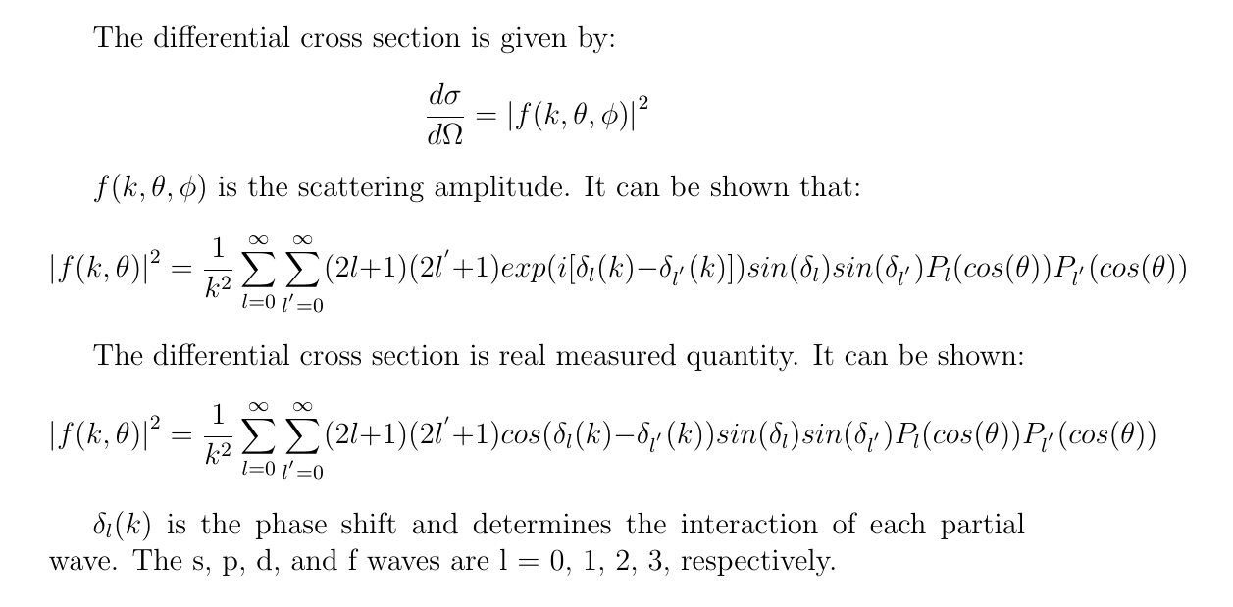
Theory

Slide 5
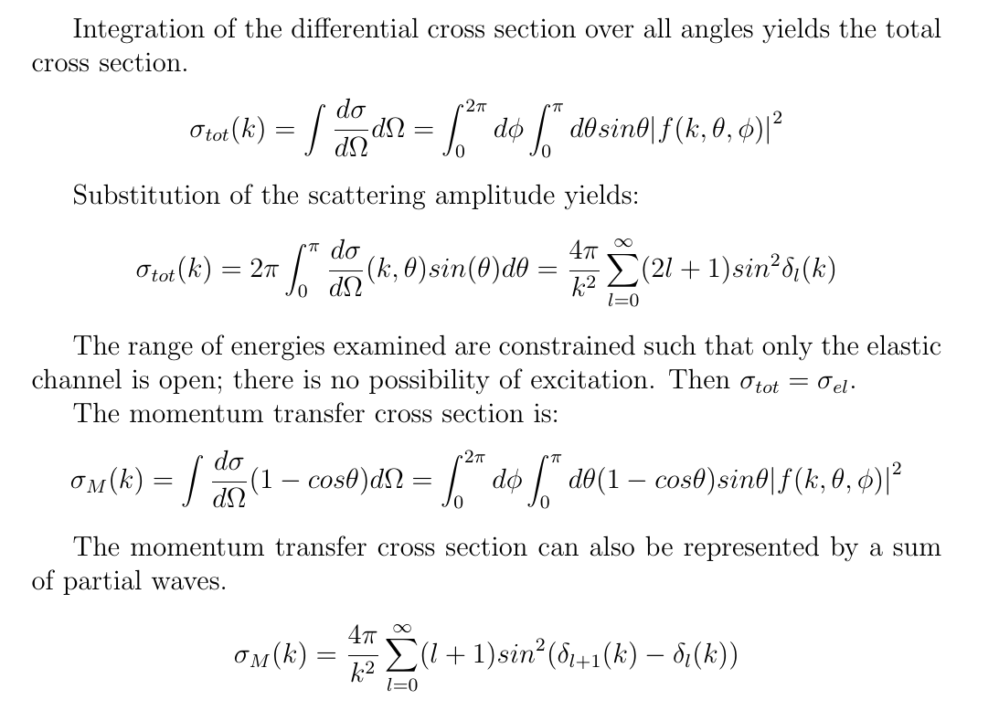
B. H. Bransden, & C. J. Joachain, (2003). Physics of atoms and molecules (2nd ed.). Harlow: Prentice Hall.

Slide 6
Purpose
Computing, examining, and comparing the elastic cross section, momentum transfer cross section, and differential cross section as a function of velocity of positron-hydrogen, positron-helium, electron-helium, positronium-helium, and electron-positronium scattering
It has been shown experimentally that positronium scattering very similar to electron scattering within certain energy ranges
Looking for notable similarities or differences in other systems and differential cross sections
Phase shifts were obtained from the literature and private communication, these were then used for the calculations
Units used: au for velocity, πa_{o}² for cross sections, a_{o}²/sr for differential cross sections
S. Brawley et al. Electron-Like Scattering of Positronium. Science, 330 (6005) (2010)
S. J. Brawley et al Phys. Rev. Lett. 115, 223201 (2015)

Slide 7
Positron-Hydrogen
Results

Slide 8
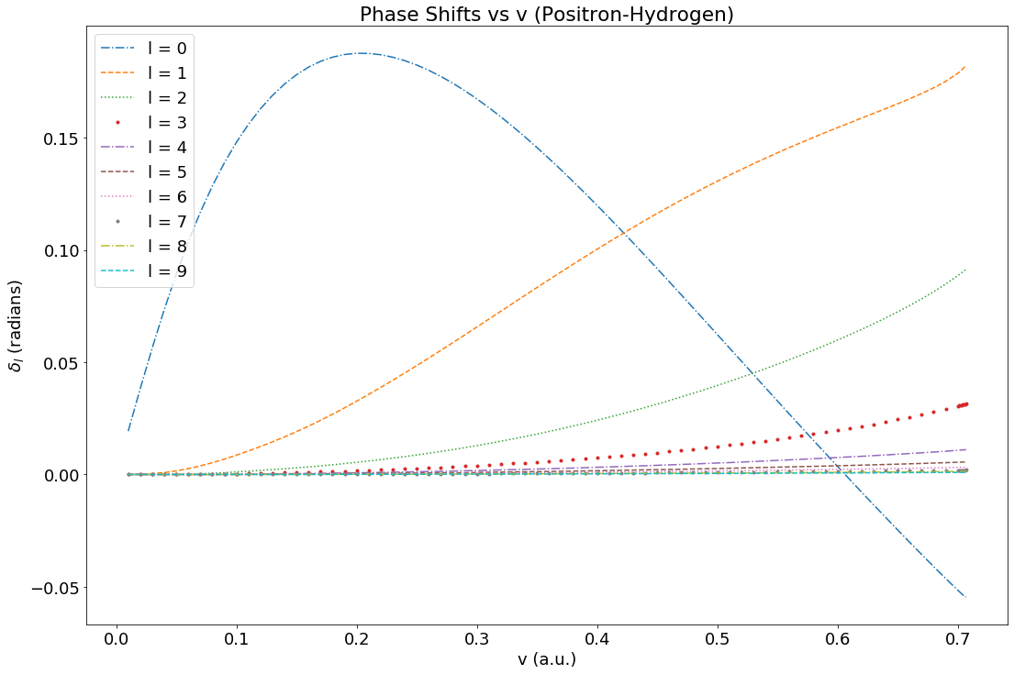
Positron-Hydrogen Phase Shifts
Phase shifts from P Van Reeth, private communication 2020

Slide 9
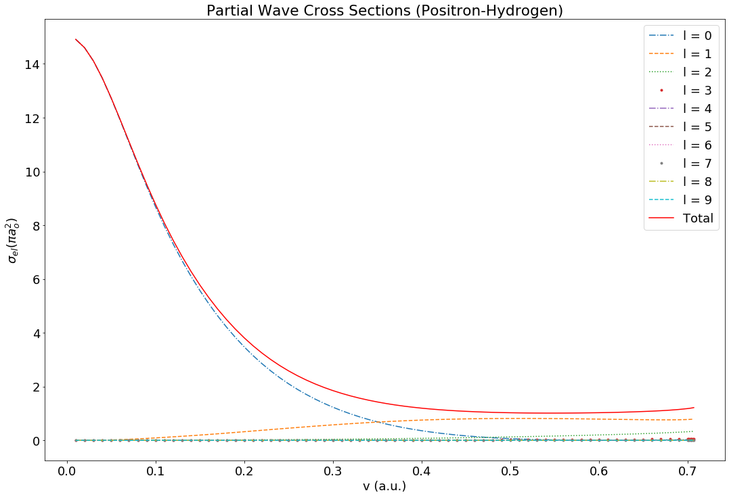
Positron-Hydrogen Elastic Cross Section
Waves l > 3 never contribute even 1% to the total cross section
S wave contribution decreases as all other increase
P Van Reeth et al 2016 J. Phys. B: At. Mol. Opt. Phys. 49 114001
Phase shifts from P Van Reeth, private communication 2020

Slide 10
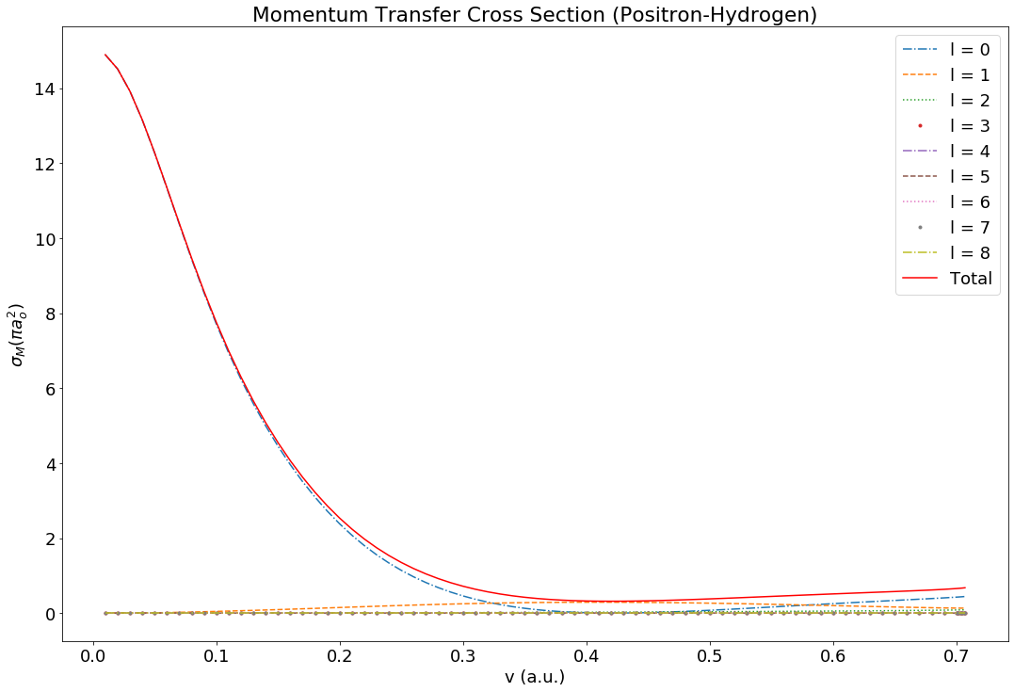
Positron-Hydrogen Momentum Transfer
On average, the momentum transfer cross section is around 55% of the elastic cross section
P Van Reeth et al 2016 J. Phys. B: At. Mol. Opt. Phys. 49 114001
Phase shifts from P Van Reeth, private communication 2020

Slide 11
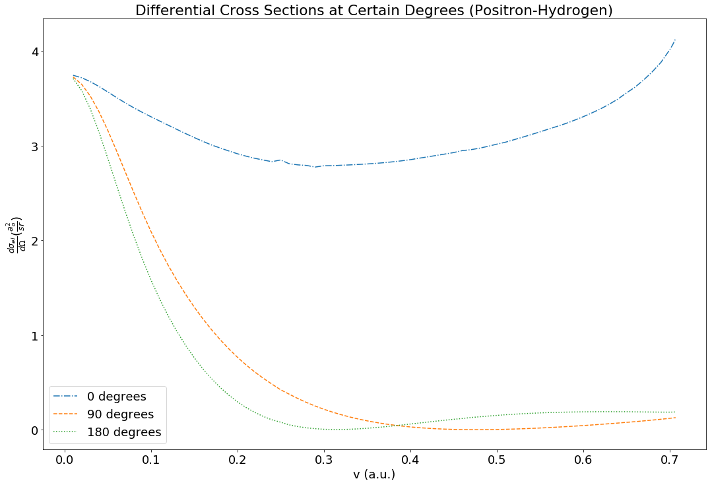
Positron-Hydrogen Differential Cross Section
P Van Reeth et al 2016 J. Phys. B: At. Mol. Opt. Phys. 49 114001
Phase shifts from P Van Reeth, private communication 2020

Slide 12
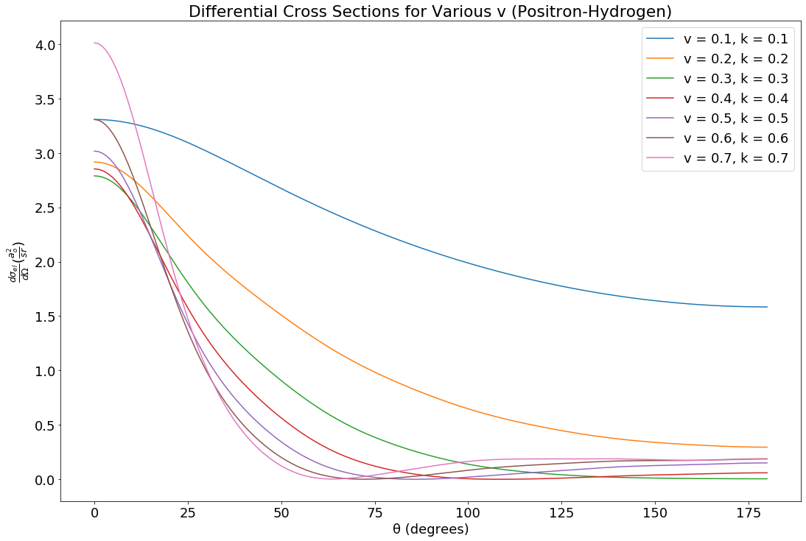
Positron-Hydrogen Differential Cross Section
Higher velocity, sharper decline
P Van Reeth et al 2016 J. Phys. B: At. Mol. Opt. Phys. 49 114001
Phase shifts from P Van Reeth, private communication 2020

Slide 13
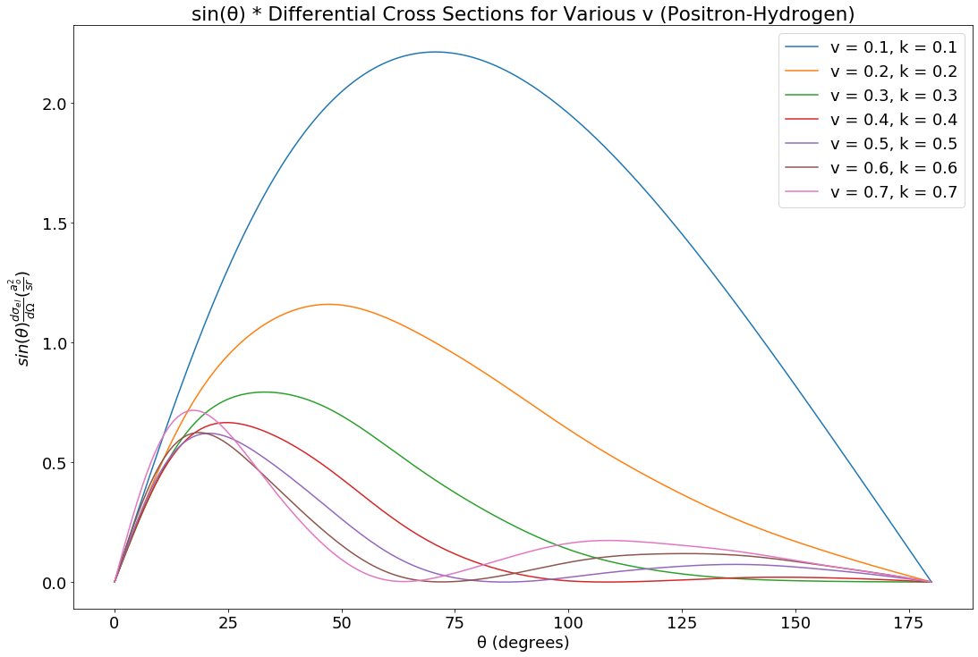
Positron-Hydrogen Differential Cross Section
P Van Reeth et al 2016 J. Phys. B: At. Mol. Opt. Phys. 49 114001
Phase shifts from P Van Reeth, private communication 2020

Slide 14
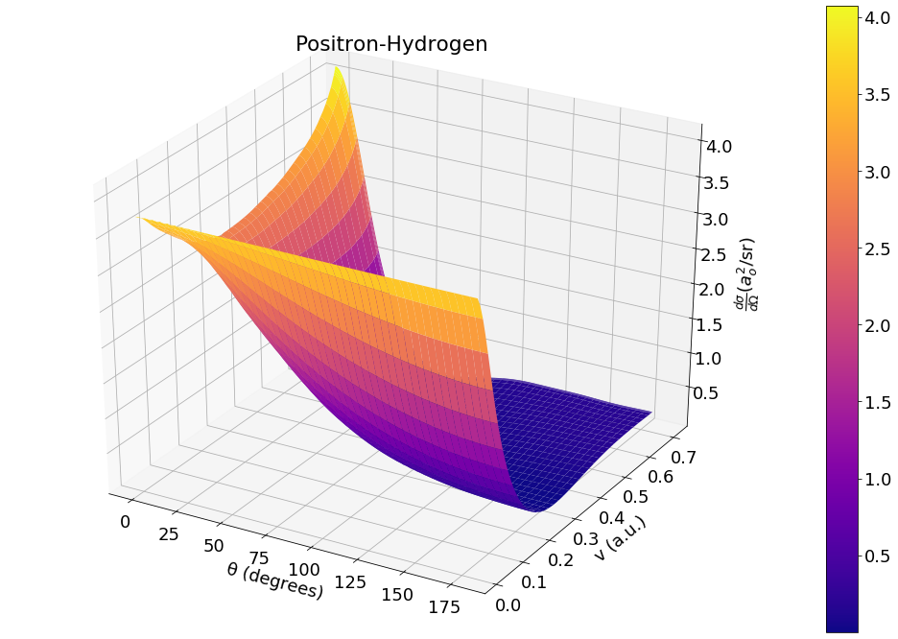
Positron-Hydrogen Differential Cross Section
P Van Reeth et al 2016 J. Phys. B: At. Mol. Opt. Phys. 49 114001
Phase shifts from P Van Reeth, private communication 2020

Slide 15
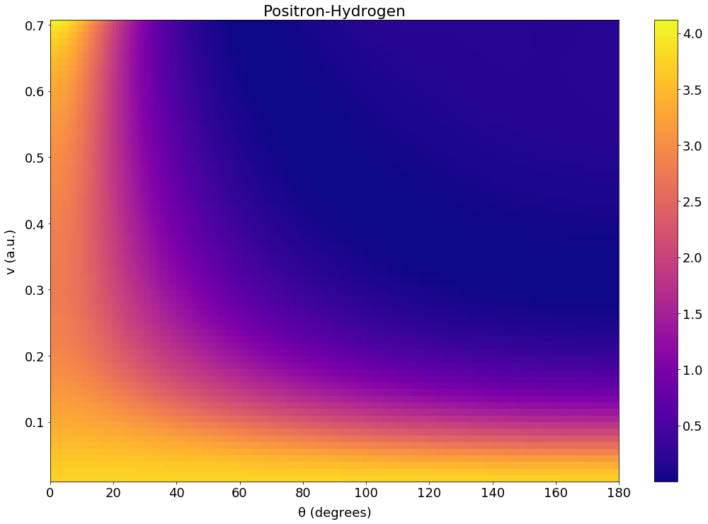
Positron-Hydrogen Differential Cross Section
P Van Reeth et al 2016 J. Phys. B: At. Mol. Opt. Phys. 49 114001
Phase shifts from P Van Reeth, private communication 2020

Slide 16
Positron-Helium

Slide 17
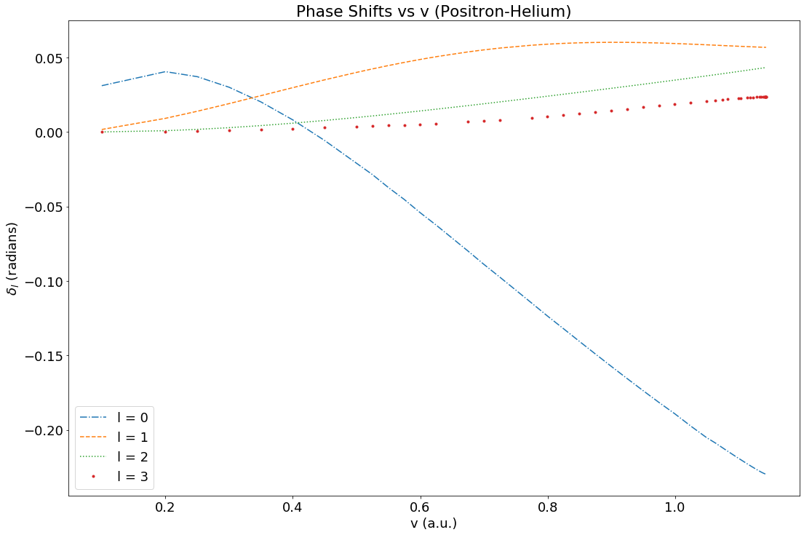
Positron-Helium Phase Shifts
Phase shifts from P Van Reeth, private communication 2020

Slide 18
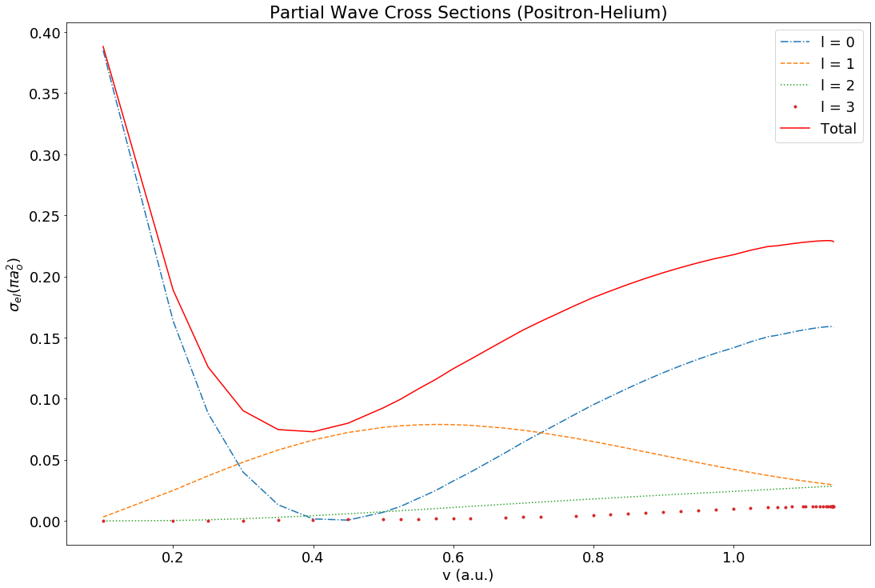
Positron-Helium Elastic Cross Section
Phase shifts from P Van Reeth, private communication 2020

Slide 19
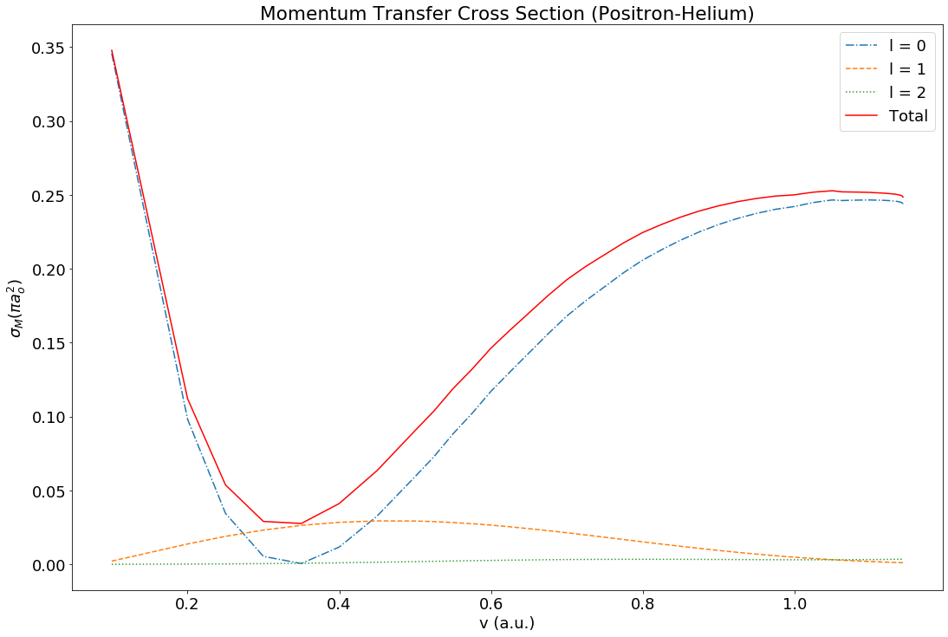
Positron-Helium Momentum Transfer Cross Section
Phase shifts from P Van Reeth, private communication 2020

Slide 20
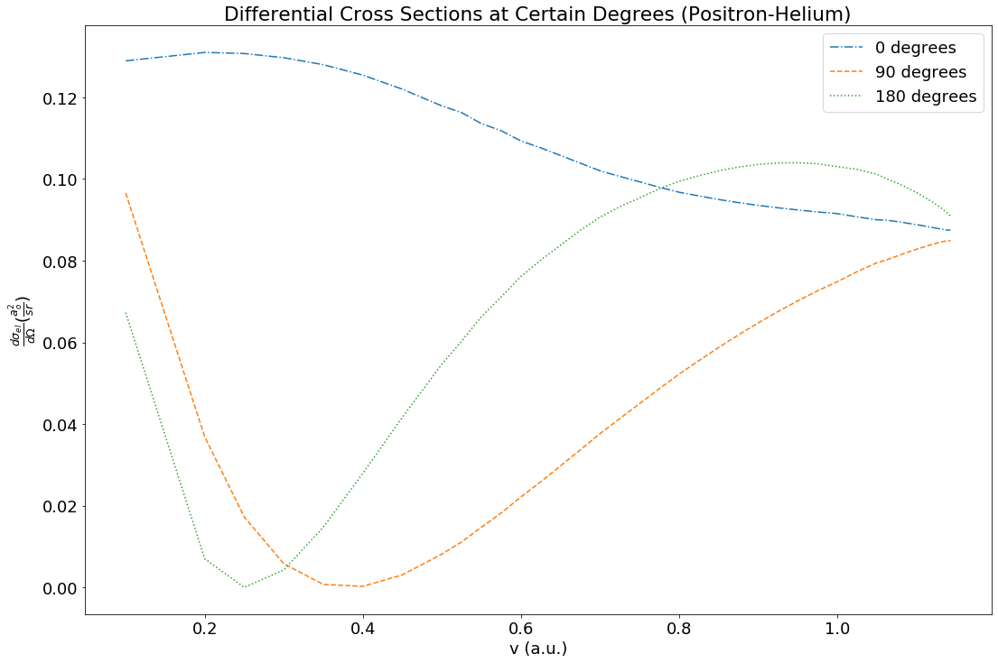
Positron-Helium Differential Cross Section
Phase shifts from P Van Reeth, private communication 2020

Slide 21
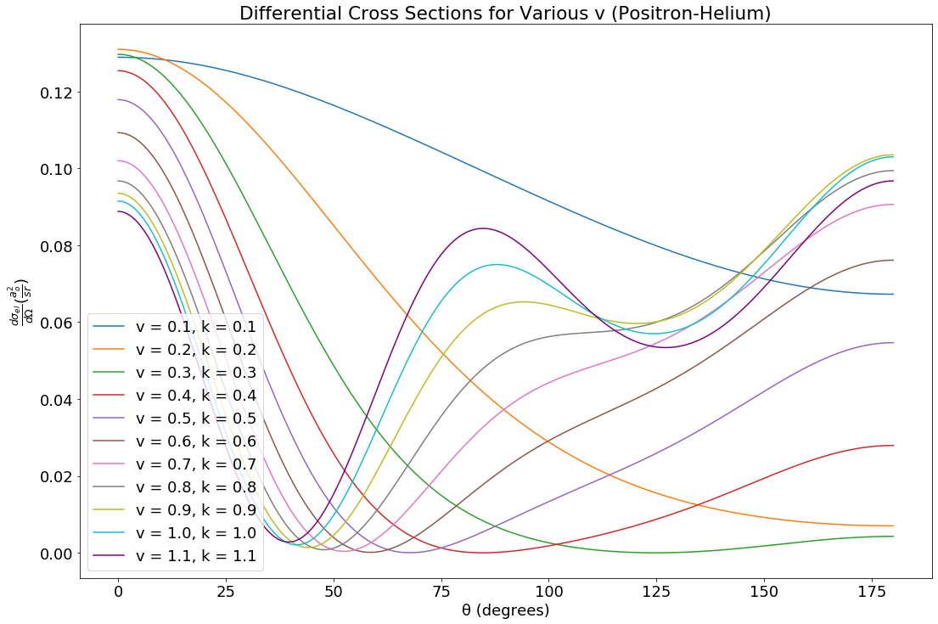
Positron-Helium Differential Cross Section
Higher velocity, sharper decline at low degree, sharper increase
Phase shifts from P Van Reeth, private communication 2020

Slide 22
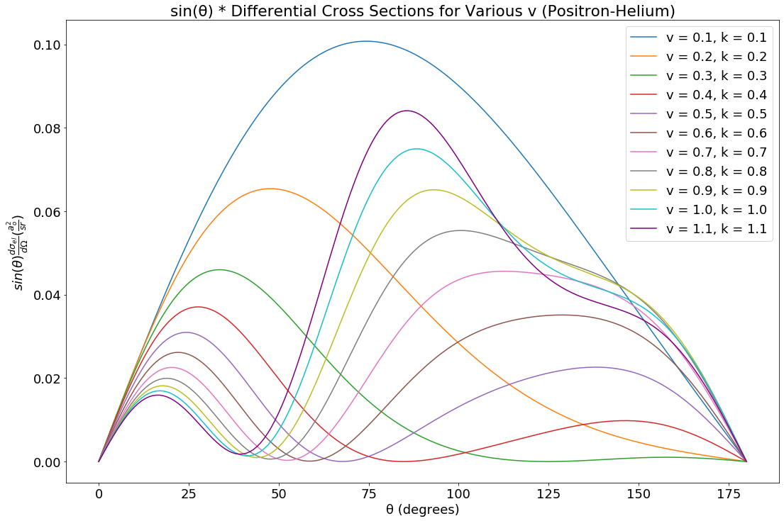
Positron-Helium Differential Cross Section
Increasing degrees shifts low degree magnitude lower, mid-range degree higher
Phase shifts from P Van Reeth, private communication 2020

Slide 23
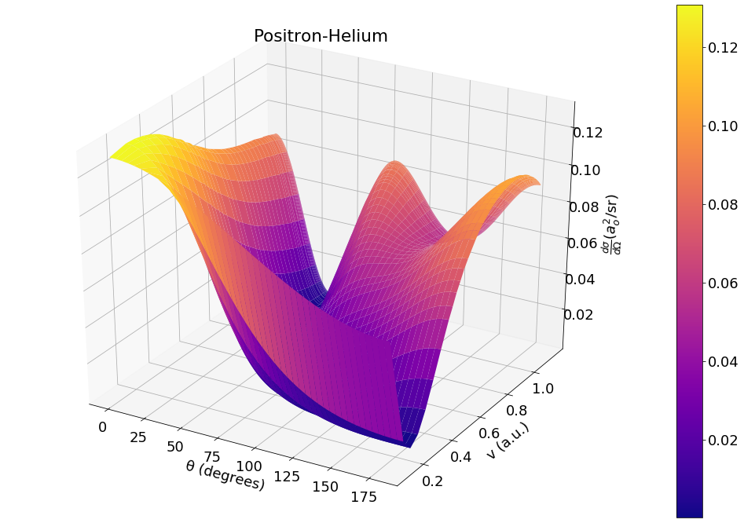
Positron-Helium Differential Cross Section
Phase shifts from P Van Reeth, private communication 2020

Slide 24
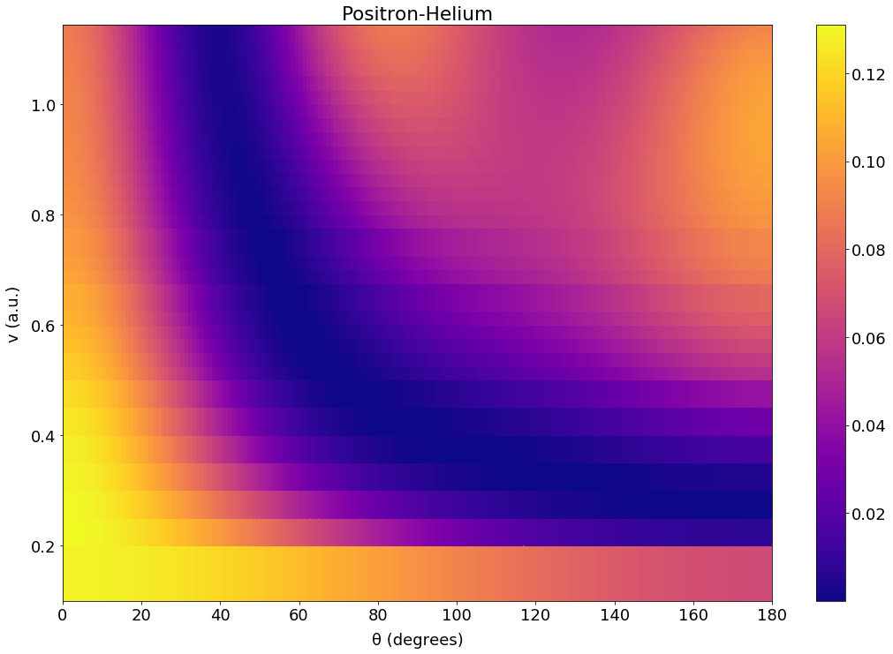
Positron-Helium Differential Cross Section
Phase shifts from P Van Reeth, private communication 2020

Slide 25
Electron-Helium

Slide 26
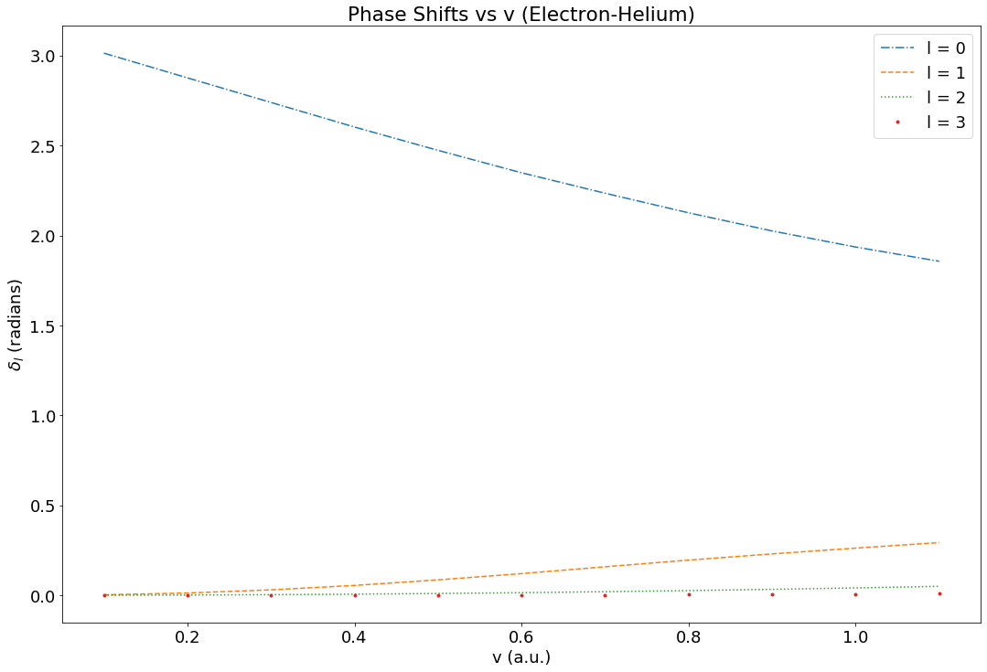
Electron-Helium Phase Shifts
Phase shifts from: A. L. Sinfailam and R K Nesbet 1972 Phys. Rev. A 6, 2118 (1972)
R. K. Nesbet Phys. Rev. A 20, 58 (1979)

Slide 27
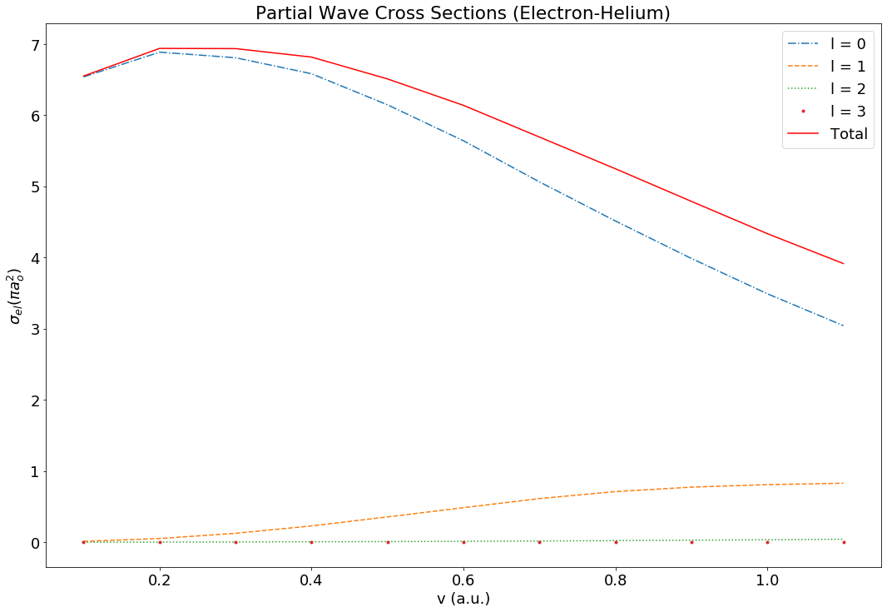
Electron-Helium Elastic Cross Section
Decrease in contribution from s wave is met with a roughly equal increase in p wave contribution
Phase shifts from: A. L. Sinfailam and R K Nesbet 1972 Phys. Rev. A 6, 2118 (1972)
R. K. Nesbet Phys. Rev. A 20, 58 (1979)

Slide 28
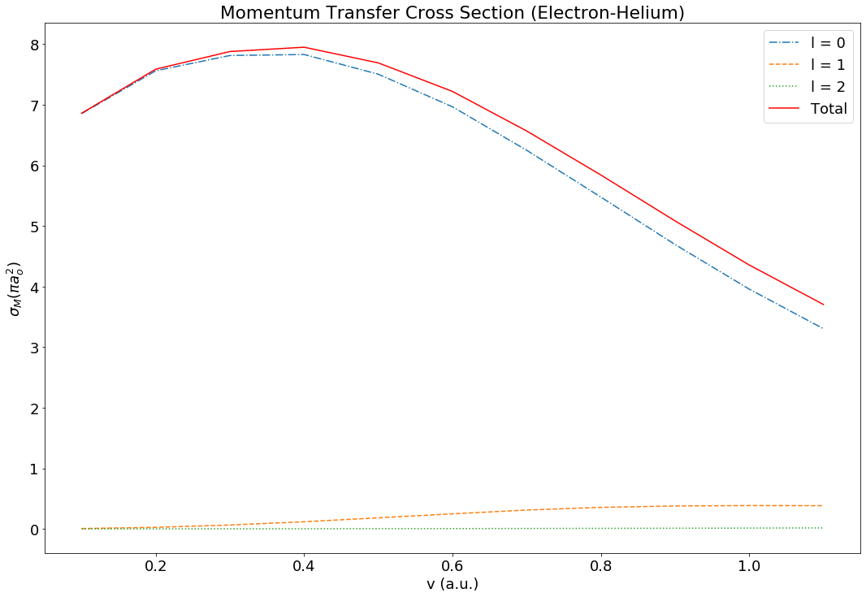
Electron-Helium Momentum Transfer Cross Section
On average about the same as the elastic cross section
Phase shifts from: A. L. Sinfailam and R K Nesbet 1972 Phys. Rev. A 6, 2118 (1972)
R. K. Nesbet Phys. Rev. A 20, 58 (1979)

Slide 29
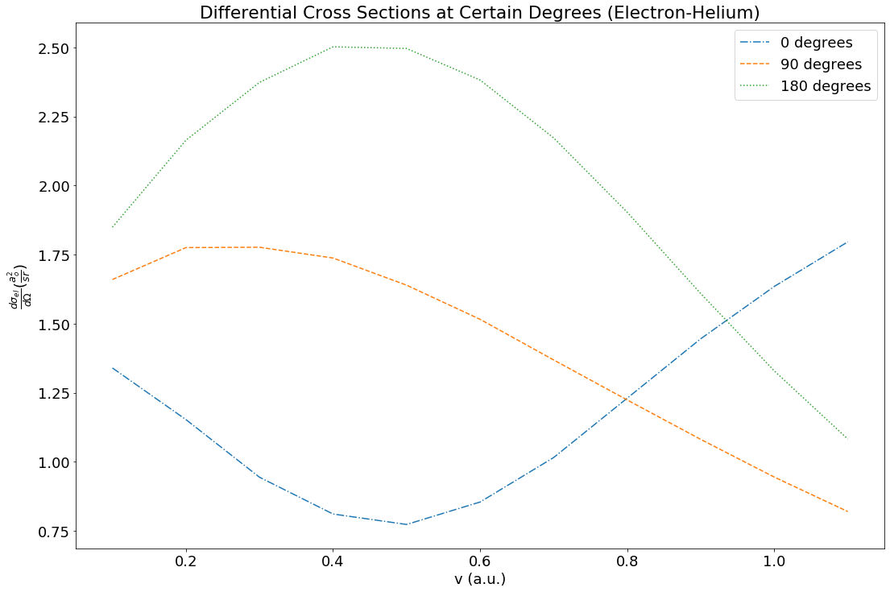
Electron-Helium Differential Cross Section
Shape at 0 degrees very similar to if 180 degrees was flipped
Phase shifts from: A. L. Sinfailam and R K Nesbet 1972 Phys. Rev. A 6, 2118 (1972)
R. K. Nesbet Phys. Rev. A 20, 58 (1979)

Slide 30
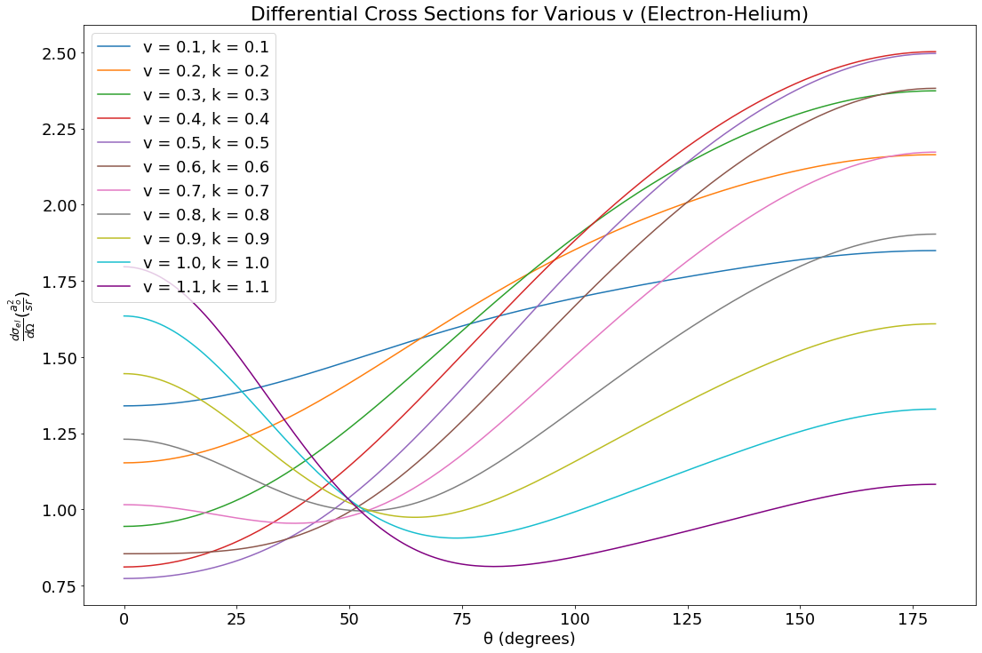
Electron-Helium Differential Cross Section
For v < 0.7, increase with greater degrees
Above this, decrease before increase
Phase shifts from: A. L. Sinfailam and R K Nesbet 1972 Phys. Rev. A 6, 2118 (1972)
R. K. Nesbet Phys. Rev. A 20, 58 (1979)

Slide 31
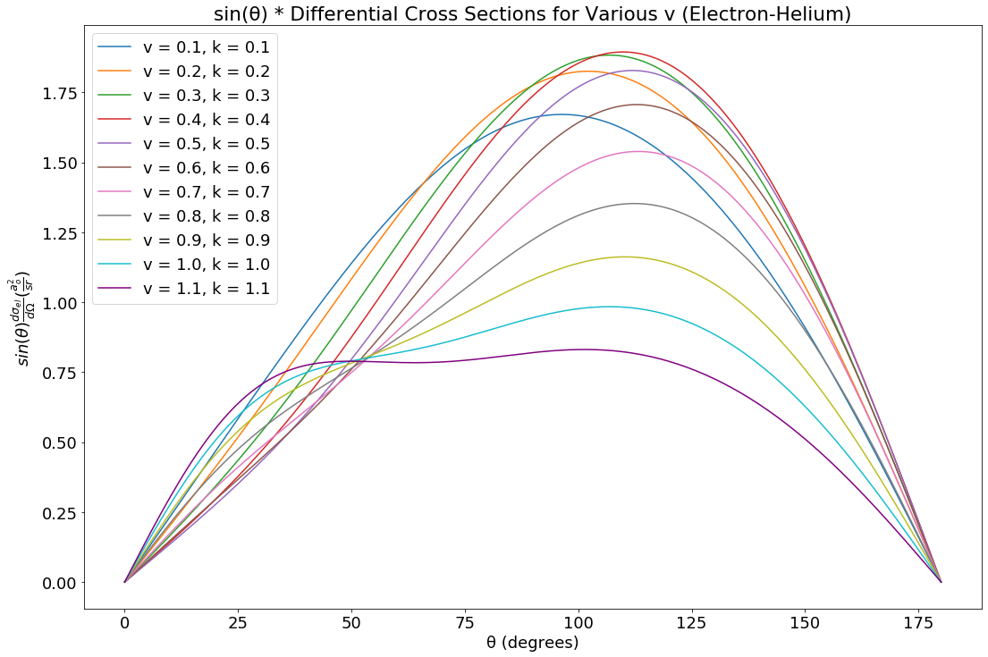
Electron-Helium Differential Cross Section
Low velocity somewhat parabolic
Higher the velocity the more smooched the ‘tip’ of the parabola
Phase shifts from: A. L. Sinfailam and R K Nesbet 1972 Phys. Rev. A 6, 2118 (1972)
R. K. Nesbet Phys. Rev. A 20, 58 (1979)

Slide 32
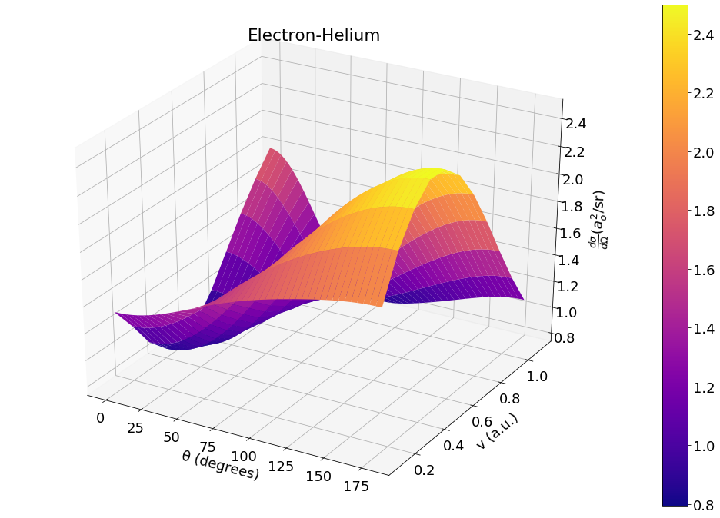
Electron-Helium Differential Cross Section
Phase shifts from: A. L. Sinfailam and R K Nesbet 1972 Phys. Rev. A 6, 2118 (1972)
R. K. Nesbet Phys. Rev. A 20, 58 (1979)

Slide 33
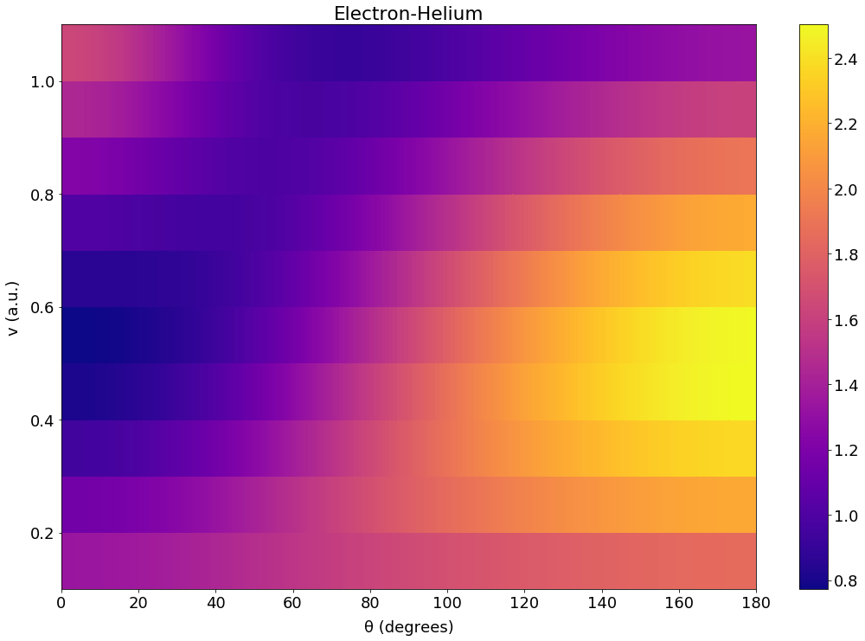
Electron-Helium Differential Cross Section
Phase shifts from: A. L. Sinfailam and R K Nesbet 1972 Phys. Rev. A 6, 2118 (1972)
R. K. Nesbet Phys. Rev. A 20, 58 (1979)

Slide 34
Positronium-Helium

Slide 35
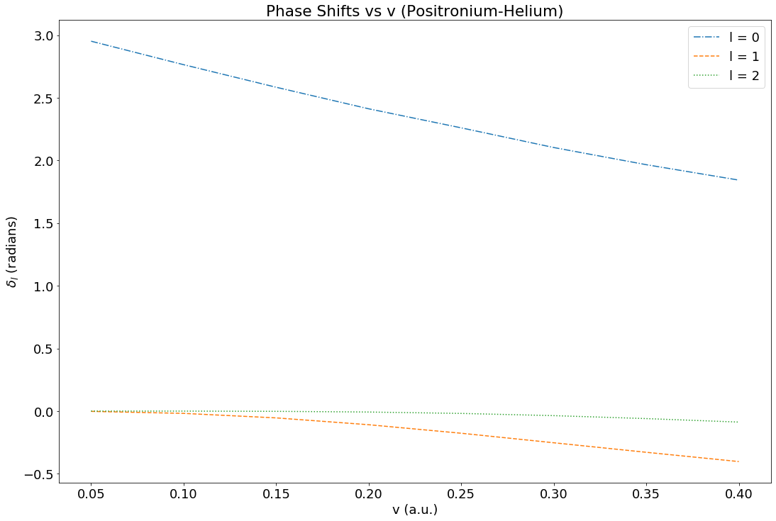
Positronium-Helium Phase Shifts
Phase shifts from:
Nirmal K Sarkar et al 1999 J. Phys. B: At. Mol. Opt. Phys. 32 1657

Slide 36
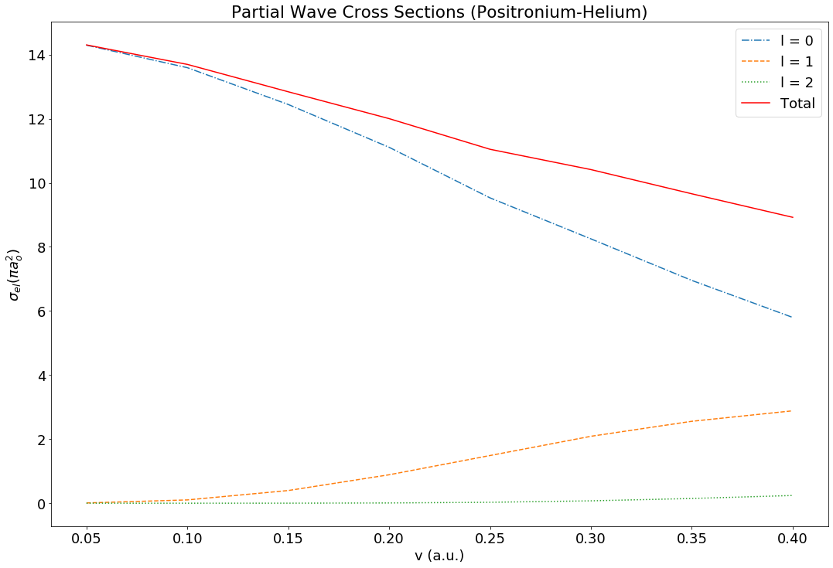
Positronium-Helium Elastic Cross Section
At highest velocity, p wave contribution is about half s wave contribution
Phase shifts from:
Nirmal K Sarkar et al 1999 J. Phys. B: At. Mol. Opt. Phys. 32 1657

Slide 37
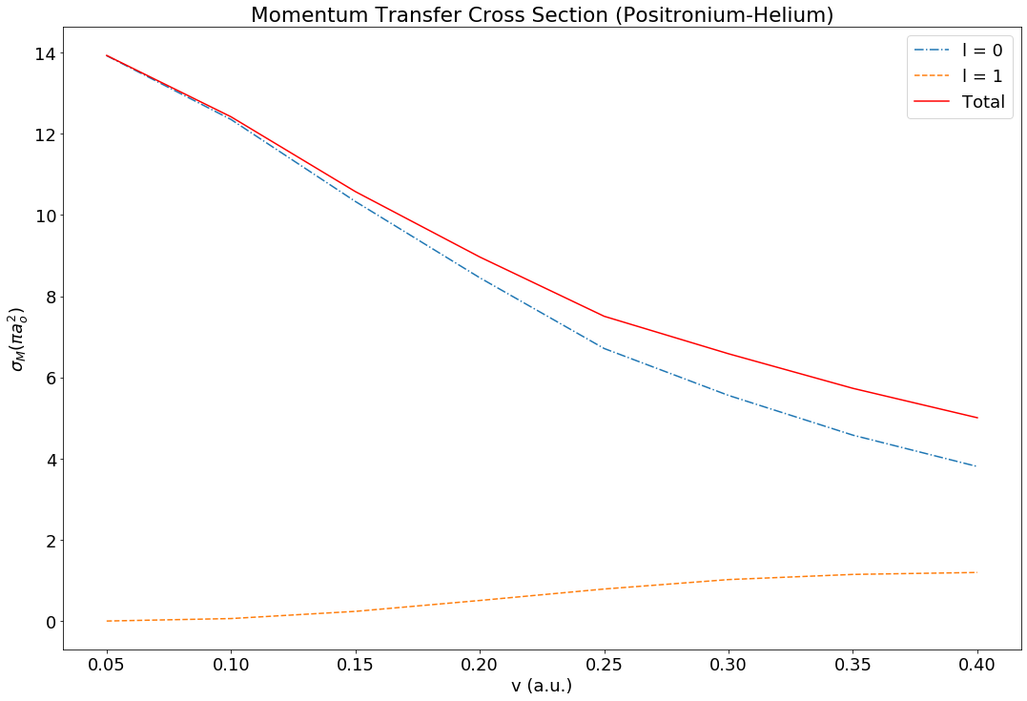
Positronium-Helium Momentum Transfer Cross Section
Always less than elastic cross section
Difference increases with velocity
Average 74%
Phase shifts from:
Nirmal K Sarkar et al 1999 J. Phys. B: At. Mol. Opt. Phys. 32 1657

Slide 38
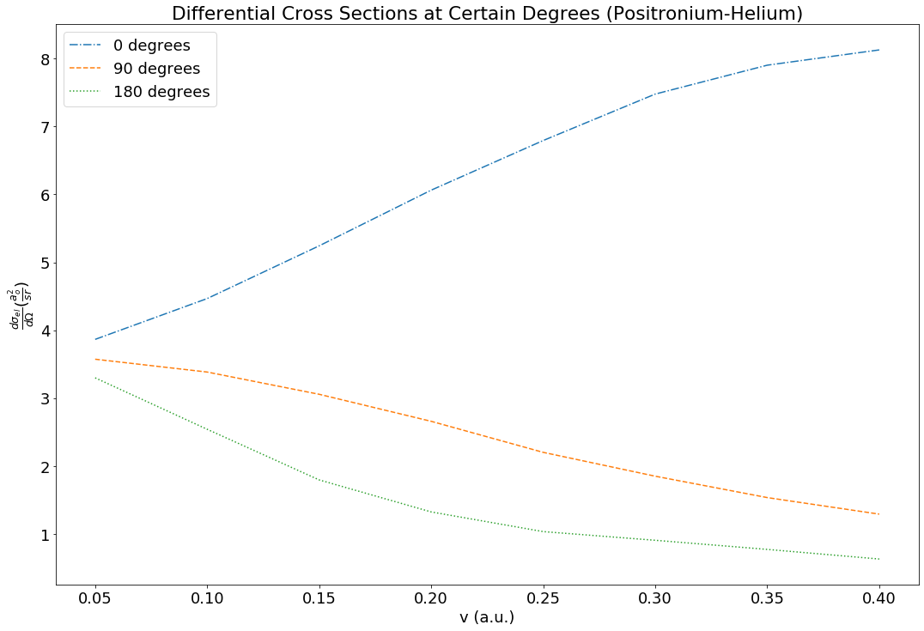
Positronium-Helium Differential Cross Section
Phase shifts from:
Nirmal K Sarkar et al 1999 J. Phys. B: At. Mol. Opt. Phys. 32 1657

Slide 39
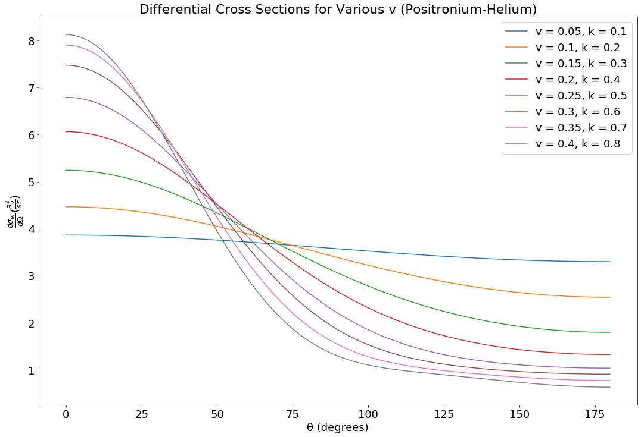
Positronium-Helium Differential Cross Section
Greater the velocity the quicker the decrease
Phase shifts from:
Nirmal K Sarkar et al 1999 J. Phys. B: At. Mol. Opt. Phys. 32 1657

Slide 40
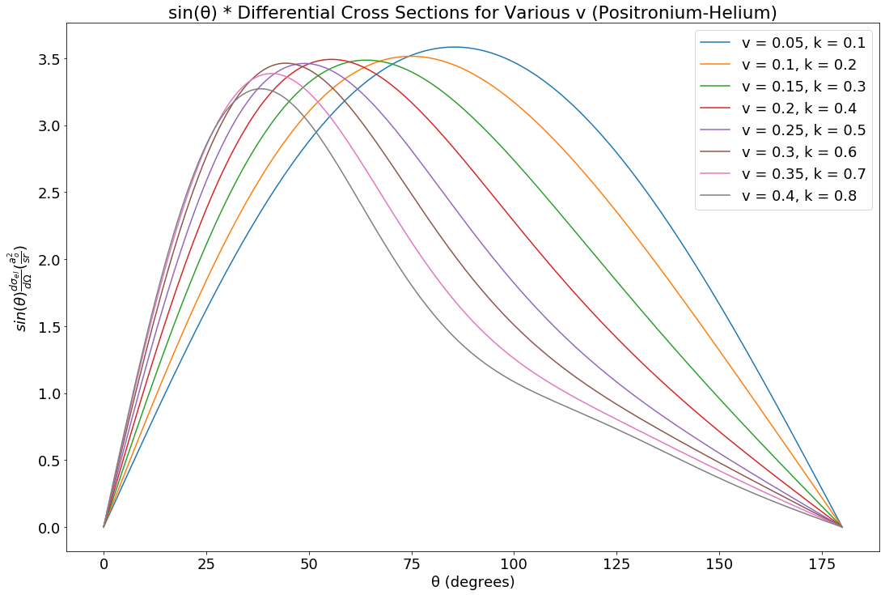
Positronium-Helium Differential Cross Section
Increase in velocity shifts the maximum for that velocity to lower degree
Phase shifts from:
Nirmal K Sarkar et al 1999 J. Phys. B: At. Mol. Opt. Phys. 32 1657

Slide 41
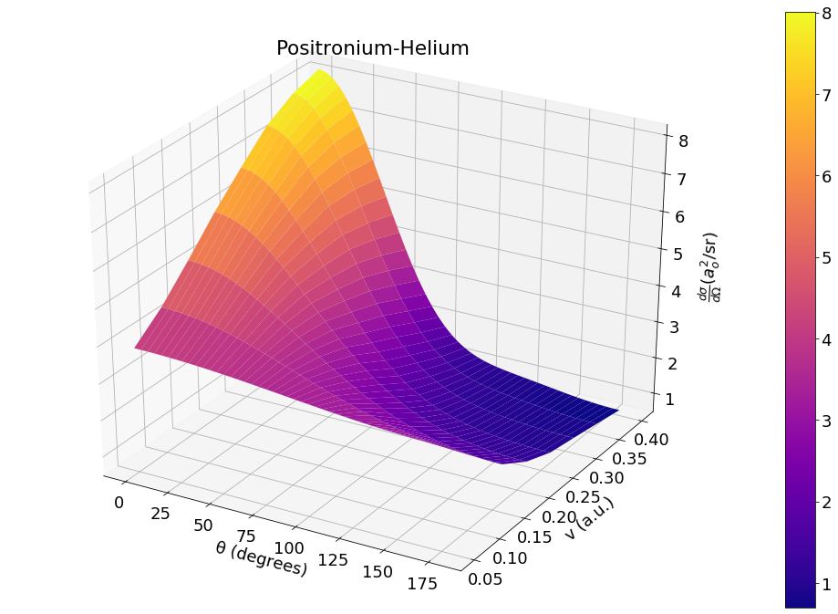
Positronium-Helium Differential Cross Section
Phase shifts from:
Nirmal K Sarkar et al 1999 J. Phys. B: At. Mol. Opt. Phys. 32 1657

Slide 42
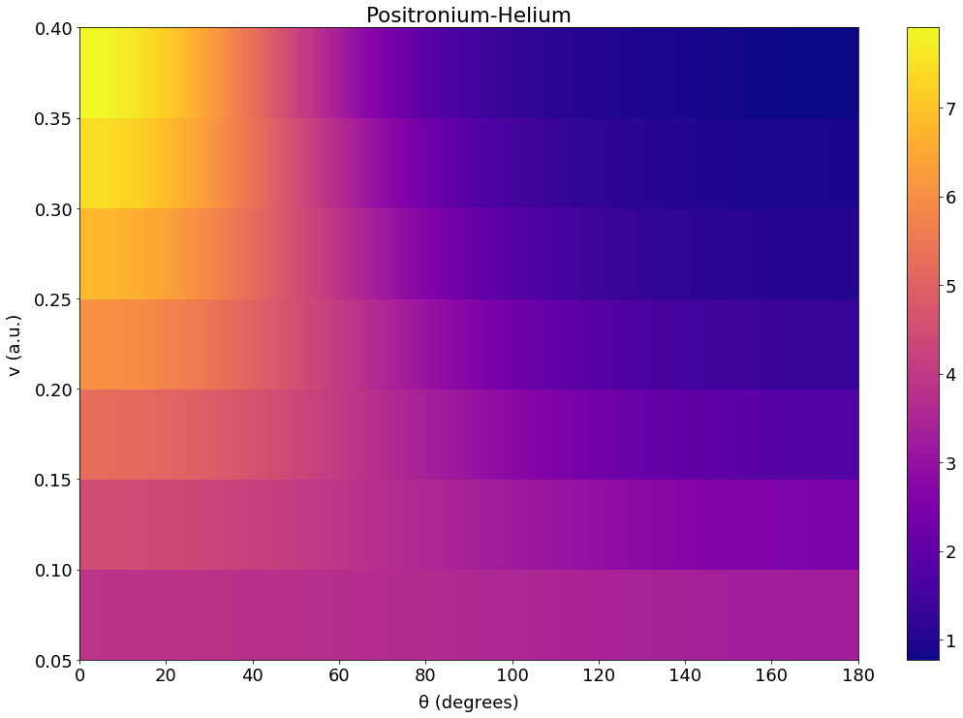
Positronium-Helium Differential Cross Section
Maximum and minimum are found at high velocity
Phase shifts from:
Nirmal K Sarkar et al 1999 J. Phys. B: At. Mol. Opt. Phys. 32 1657

Slide 43
Positronium-Helium vs Electron-Helium
Comparing Systems

Slide 44
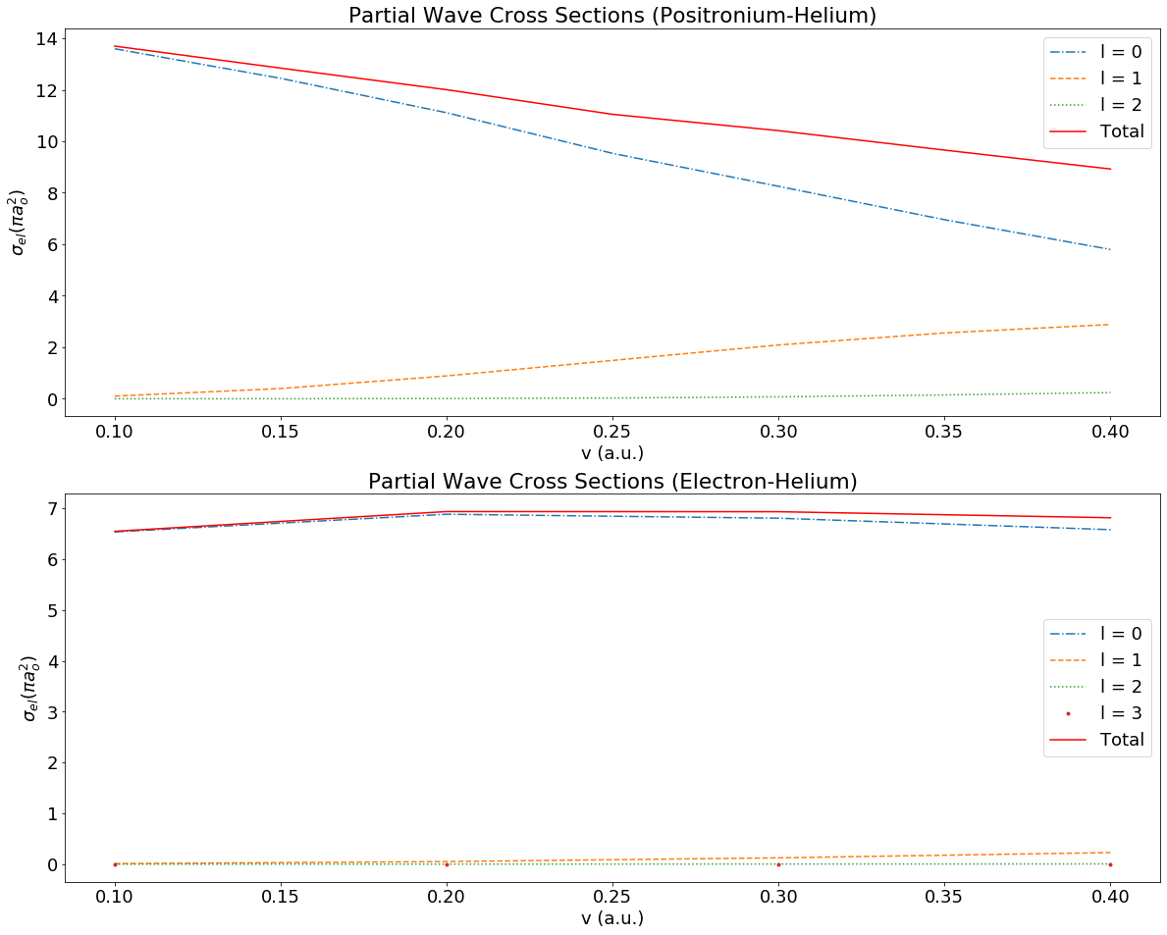
Positronium-Helium vs Electron-Helium
e-He stays flat, ps-He decrease
Elastic cross section becomes increasingly similar
At lowest velocity e-He is 48% of ps-He
Highest velocity 76%
Incredibly similar compared to ps-He vs e⁺-He

Slide 45
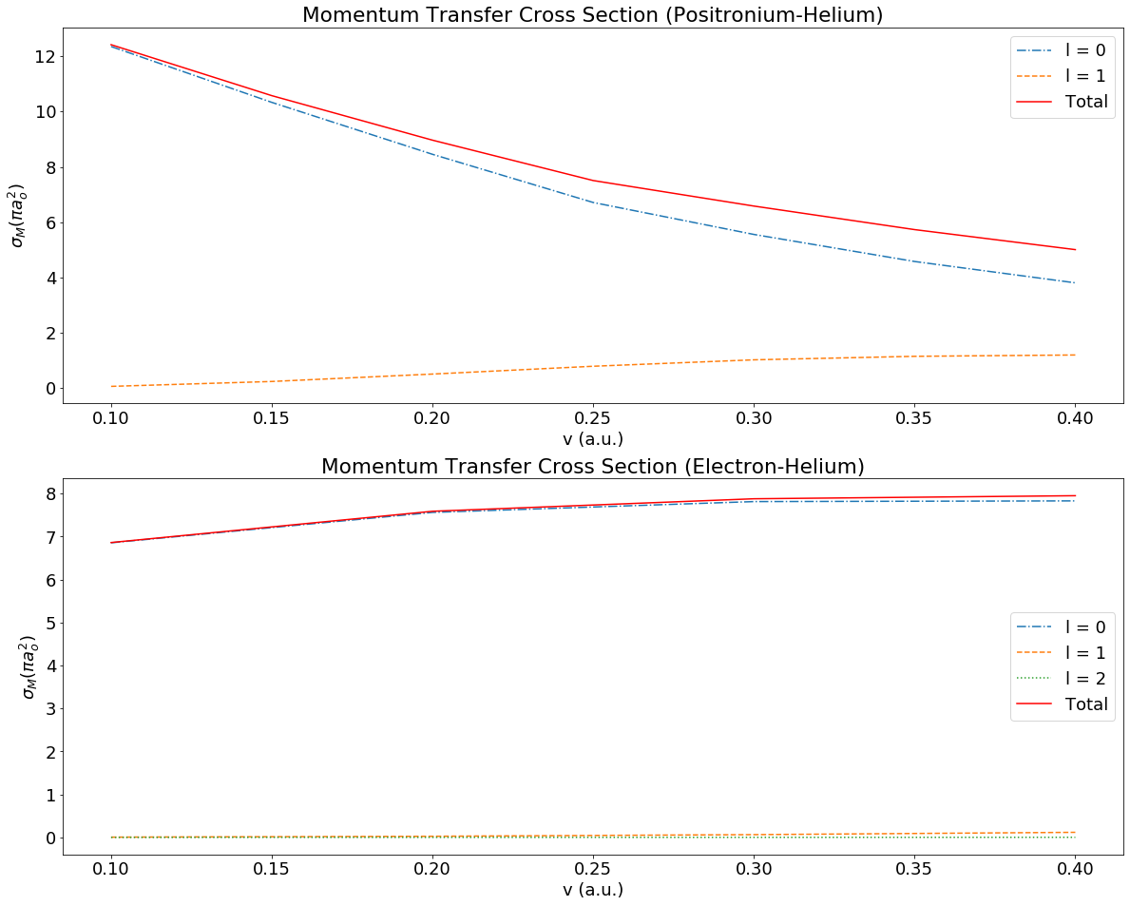
Positronium-Helium vs Electron-Helium
Ps-He decreases more than elastic cross section
Here the magnitude for e-He ends up being greater

Slide 46
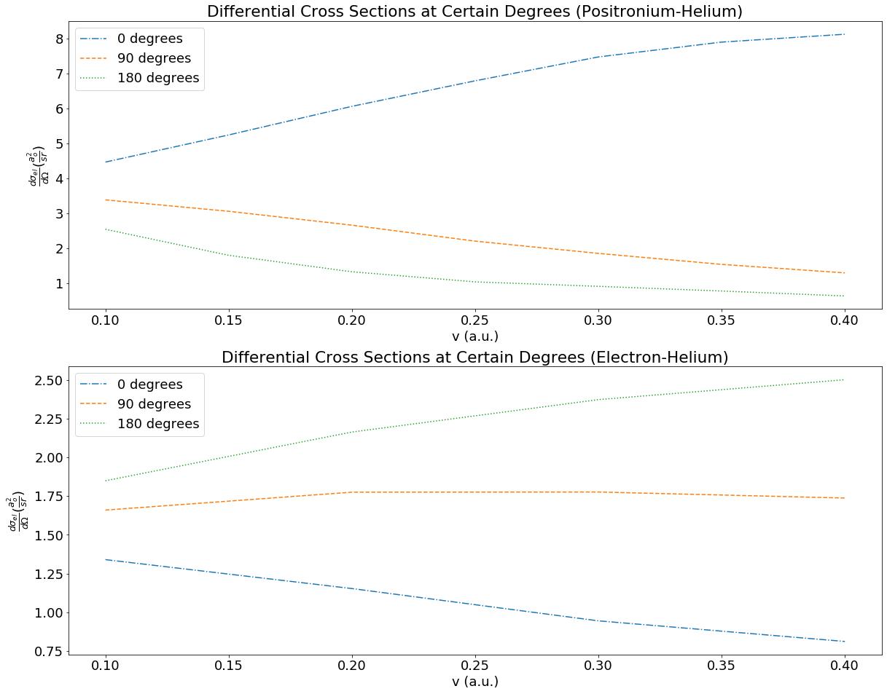
Positronium-Helium vs Electron-Helium
Shape of one at 0 degrees very similar to the other’s at 180 degrees

Slide 47
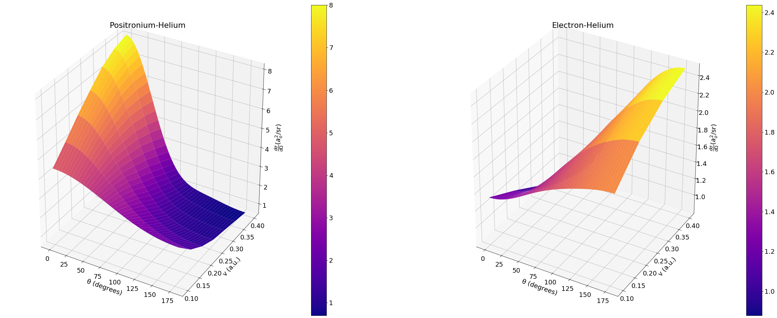
Positronium-Helium vs Electron-Helium

Slide 48
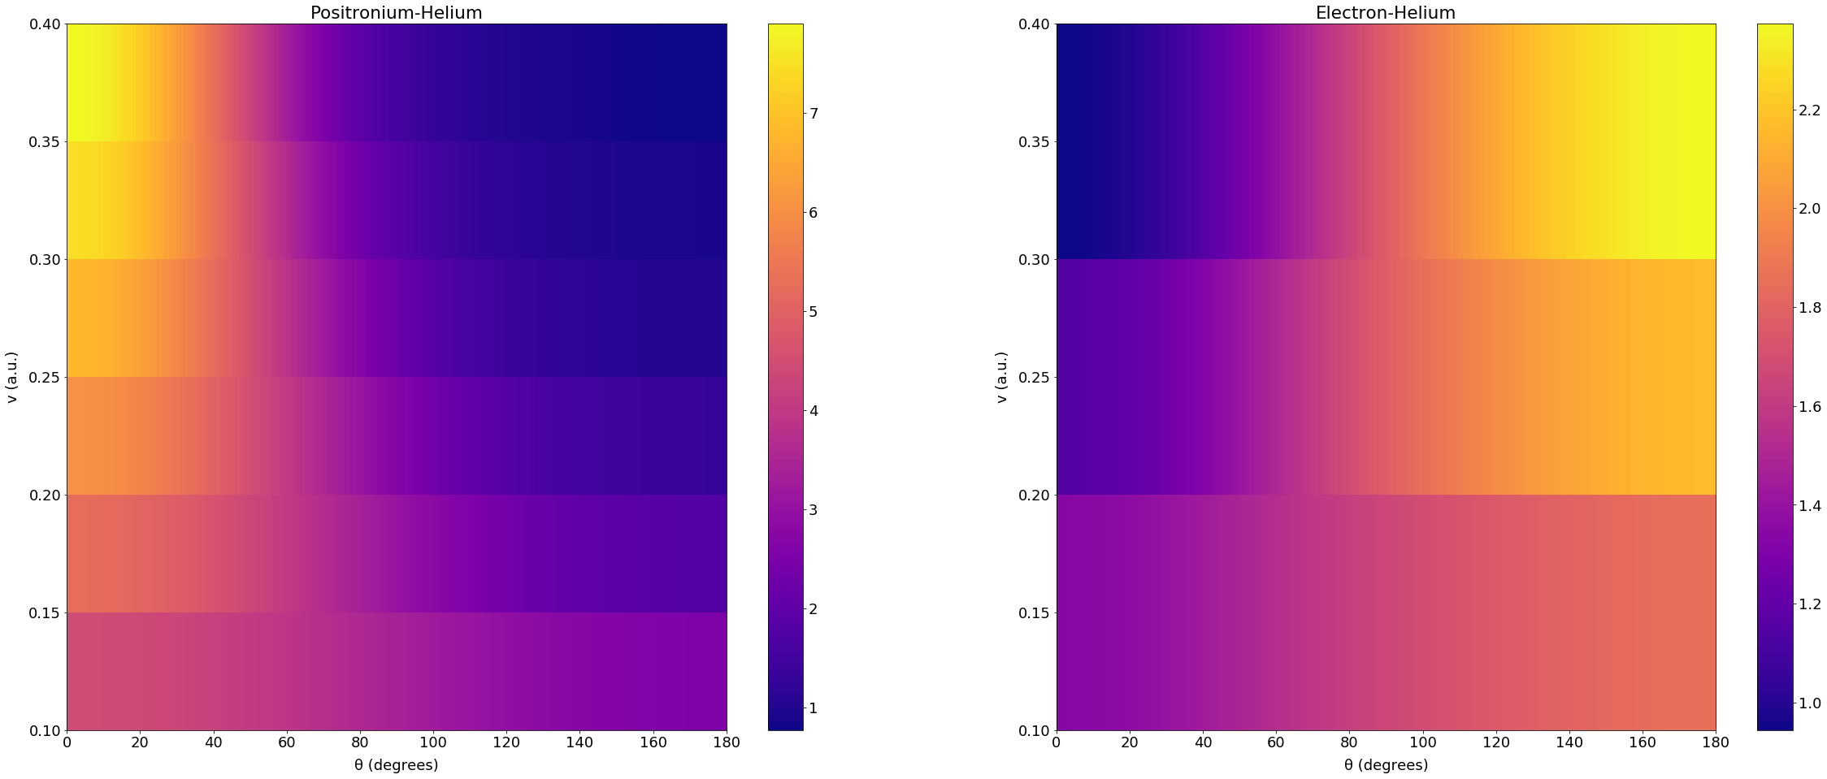
Positronium-Helium vs Electron-Helium
One looks very much like the inverse of the other
Just in shape, overall magnitude of Ps-He greater

Slide 49
Positron-Helium vs Electron-Helium

Slide 50
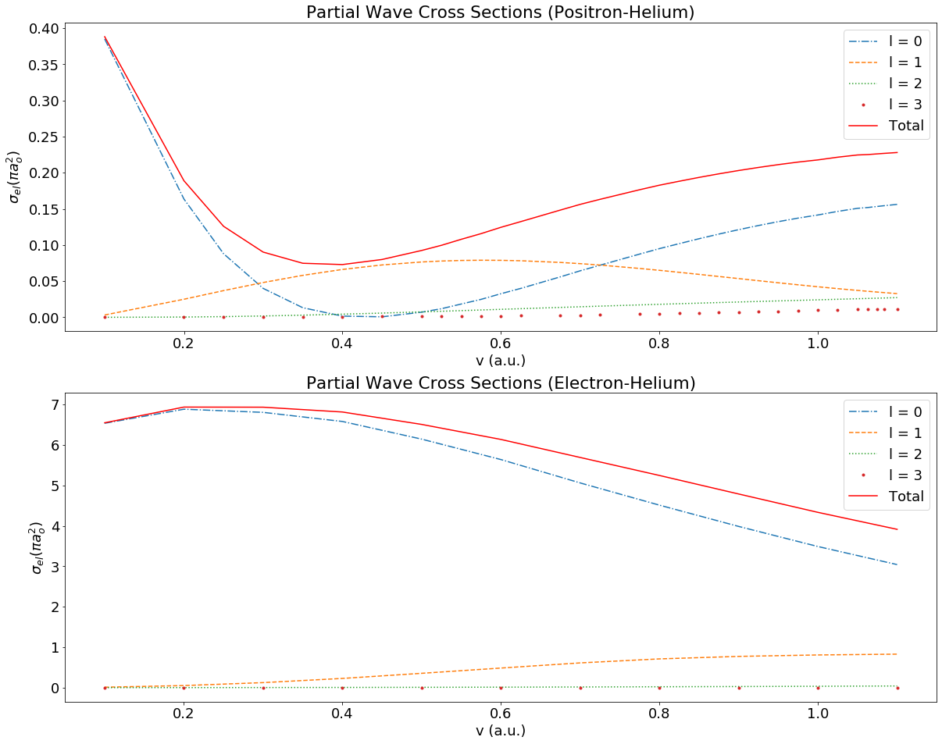
Positron-Helium vs Electron-Helium: Elastic Cross Section
Not similar
e-He far greater

Slide 51
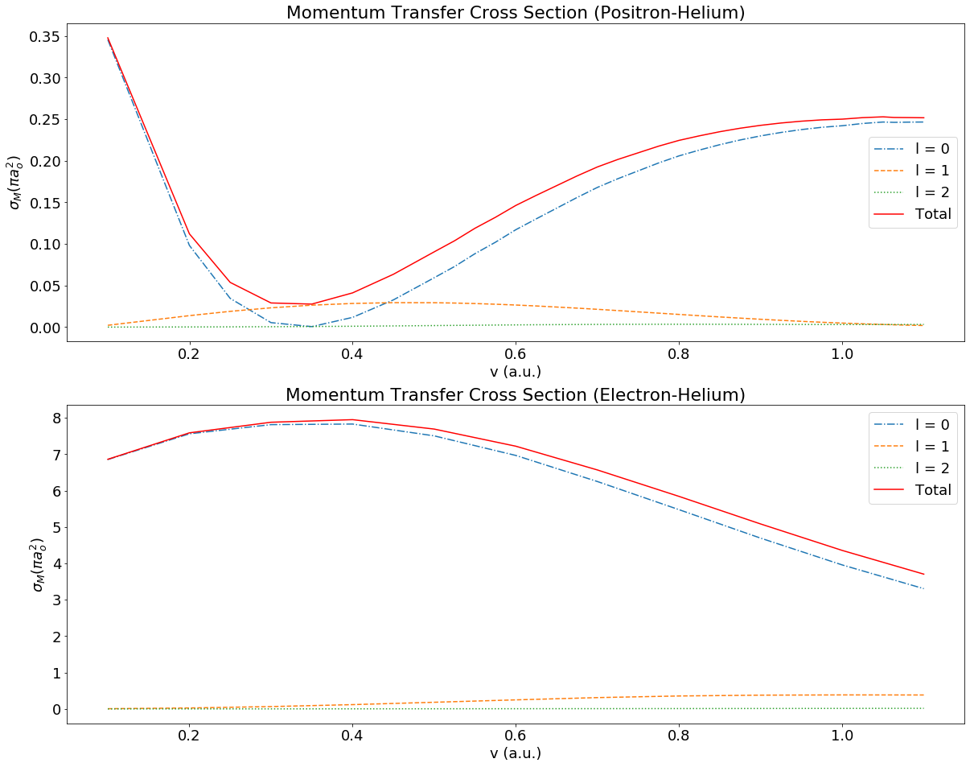
Positron-Helium vs Electron-Helium
Extremes amplified
Max difference greater
Min difference less

Slide 52
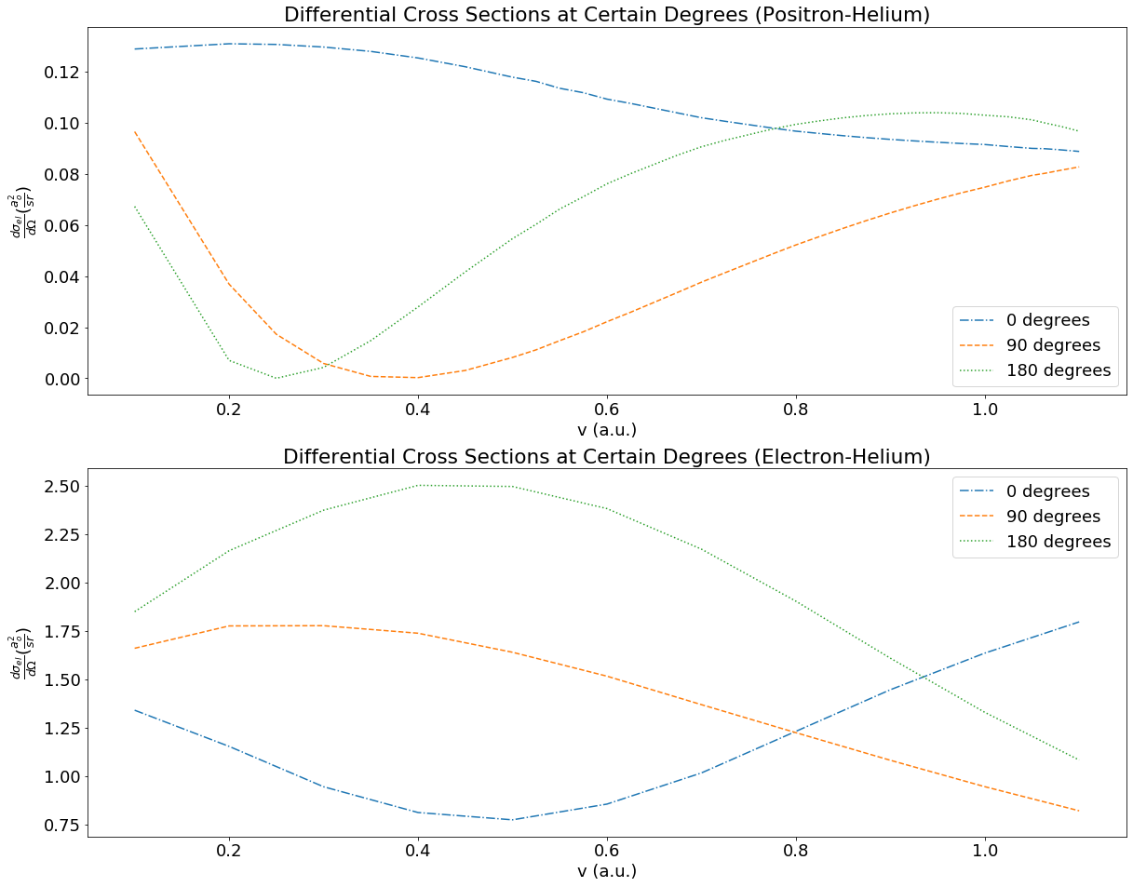
Positron-Helium vs Electron-Helium

Slide 53
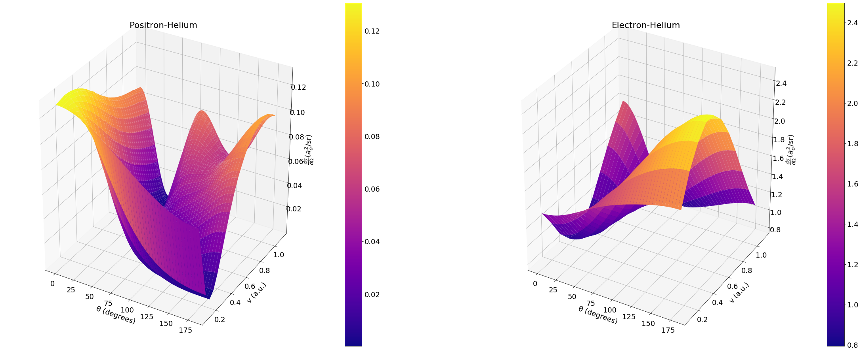
Positron-Helium vs Electron-Helium

Slide 54
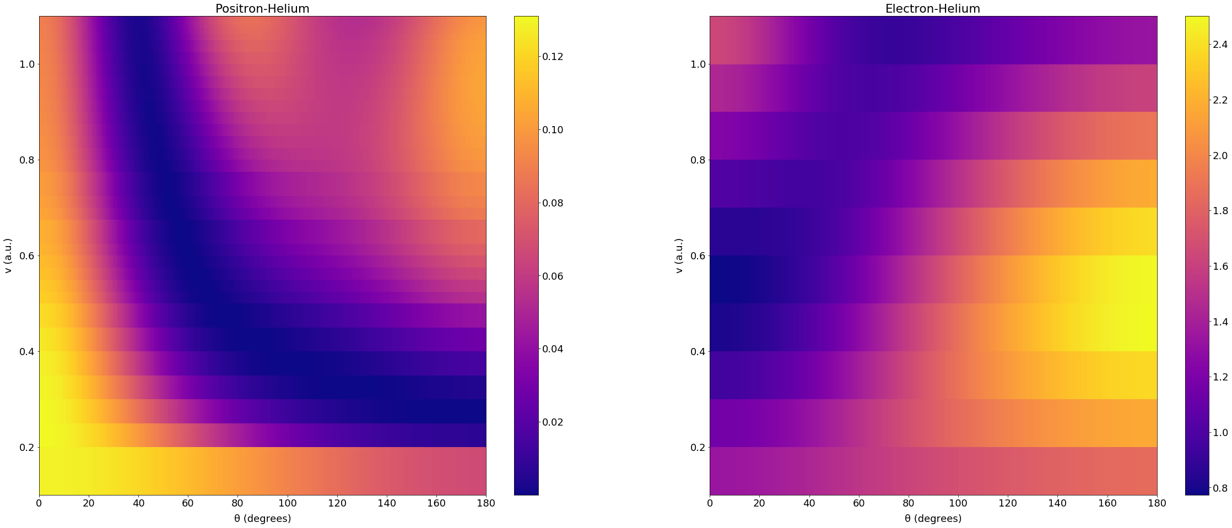
Positron-Helium vs Electron-Helium

Slide 55
Positronium-Helium vs Positron-Helium

Slide 56
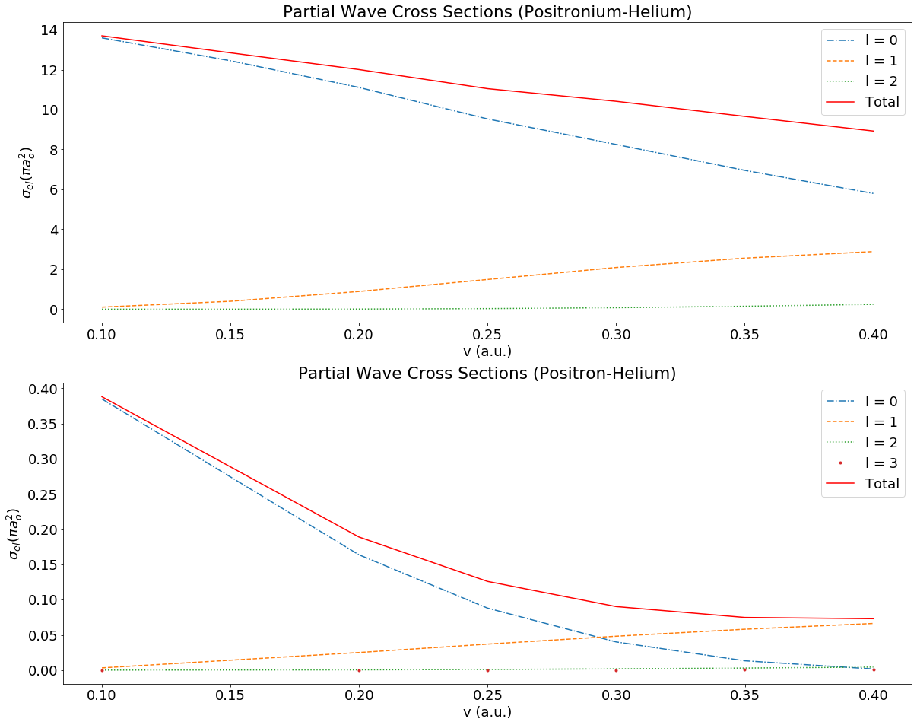
Positronium-Helium vs Positron-Helium
e⁺-He not even 2% of Ps-He
Incredibly different from the comparison of e-He and Ps-He. e-He on average 62% of Ps-He
Surprising given composition of positronium

Slide 57
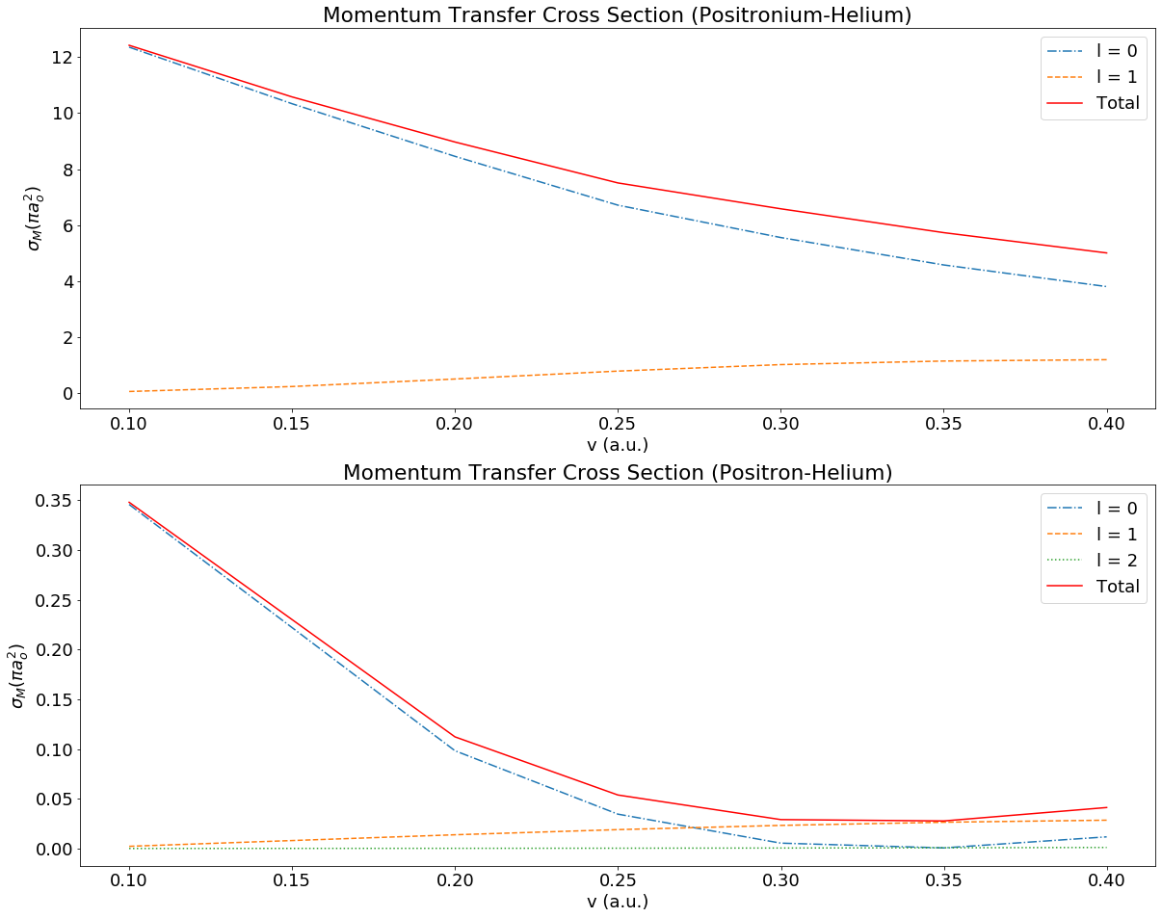
Positronium-Helium vs Positron-Helium
Difference is mostly same as elastic cross section

Slide 58
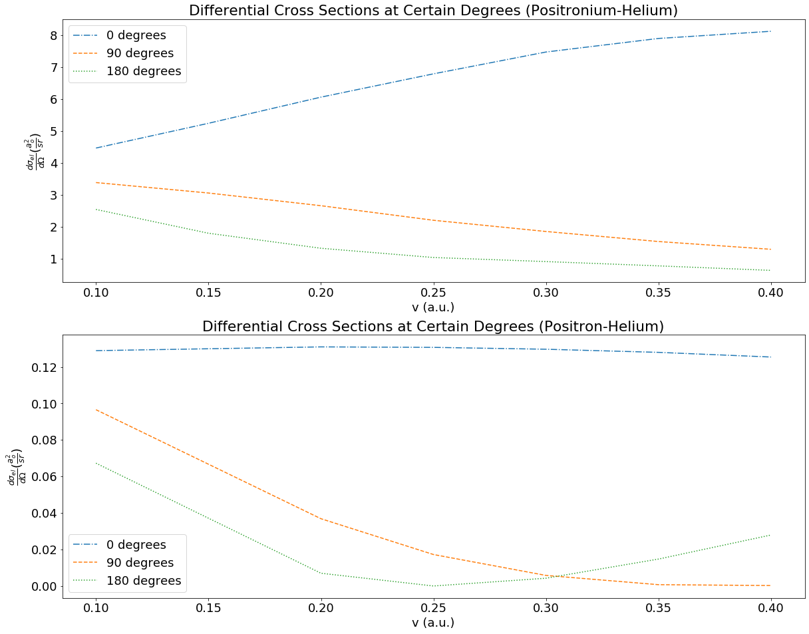
Positronium-Helium vs Positron-Helium

Slide 59
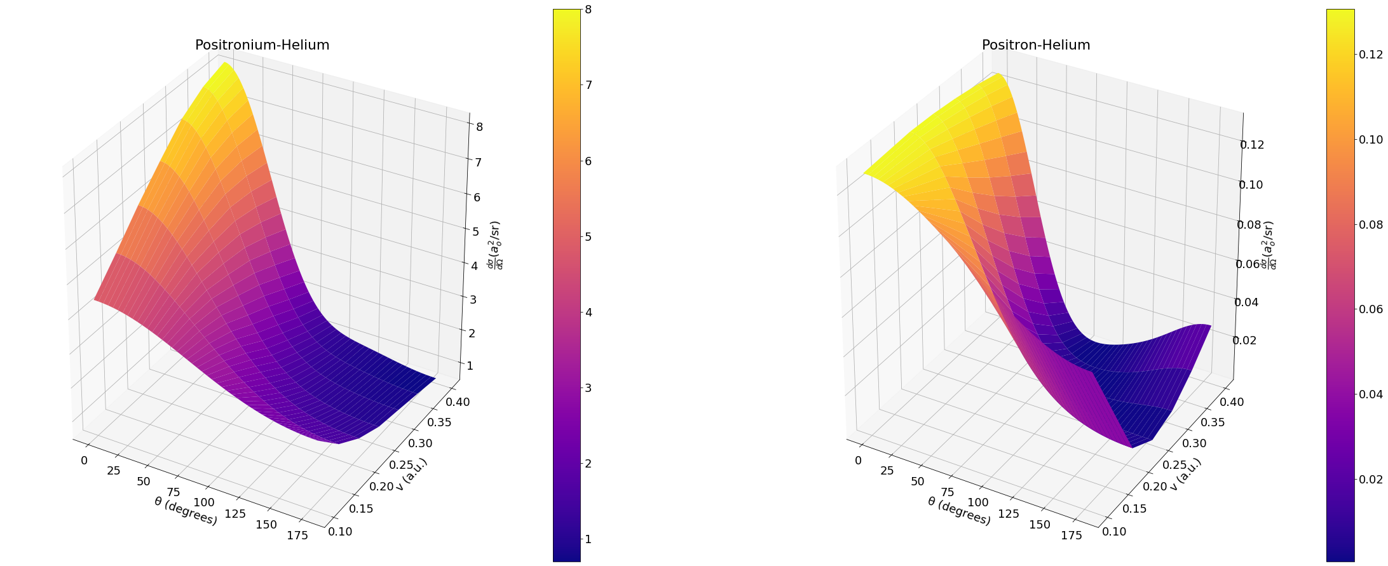
Positronium-Helium vs Positron-Helium

Slide 60
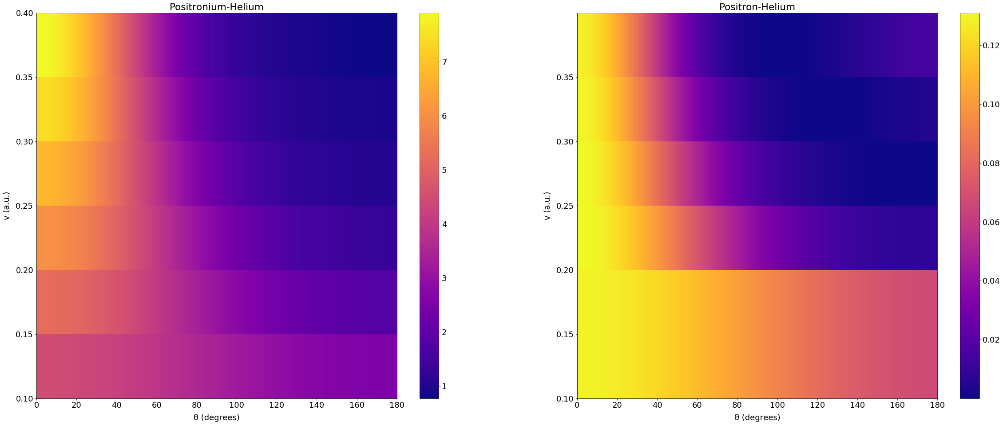
Positronium-Helium vs Positron-Helium
Beyond v = 0.2 shape is similar except for a slight rise for e⁺-He

Slide 61
Positron-Hydrogen vs Positron-Helium

Slide 62
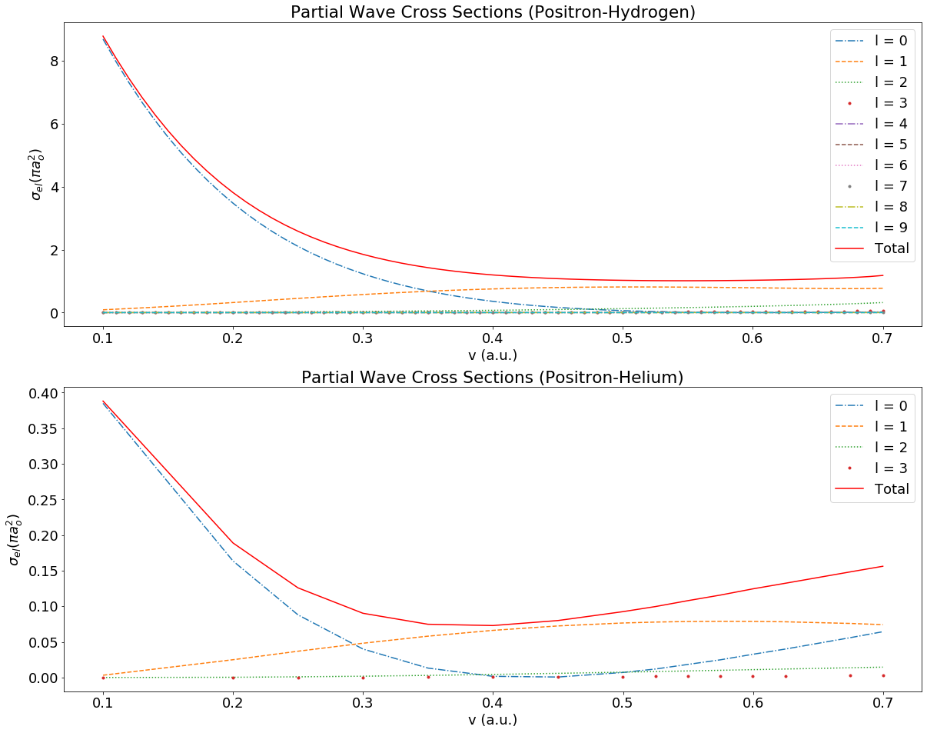
Positron-Hydrogen vs Positron-Helium
Below v = 0.4 shape is similar
Magnitude of e⁺-H greater than e⁺-He

Slide 63

Positron-Hydrogen vs Positron-Helium

Slide 64

Positron-Hydrogen vs Positron-Helium

Slide 65

Positron-Hydrogen vs Positron-Helium

Slide 66

Positron-Hydrogen vs Positron-Helium
Similar shape outside of high velocity, high degree

Slide 67
Electron-Positronium

Slide 68

Electron-Positronium Elastic Cross Section
Sharp decrease in s wave, increase in p wave
Finishes very close
Phase Shifts from:
S J Ward et al 1987 J. Phys. B: At. Mol. Opt. Phys 20
A. Igarashi, S. Nakazaki, and A. Ohsaki Phys. Rev. A 61, 032710 (2000)

Slide 69

Electron-Positronium Momentum Transfer Cross Section
Phase Shifts from:
S J Ward et al 1987 J. Phys. B: At. Mol. Opt. Phys 20
A. Igarashi, S. Nakazaki, and A. Ohsaki Phys. Rev. A 61, 032710 (2000)

Slide 70

Electron-Positronium Differential Cross Section
Phase Shifts from:
S J Ward et al 1987 J. Phys. B: At. Mol. Opt. Phys 20
A. Igarashi, S. Nakazaki, and A. Ohsaki Phys. Rev. A 61, 032710 (2000)

Slide 71

Electron-Positronium Differential Cross Section
Phase Shifts from:
S J Ward et al 1987 J. Phys. B: At. Mol. Opt. Phys 20
A. Igarashi, S. Nakazaki, and A. Ohsaki Phys. Rev. A 61, 032710 (2000)

Slide 72

Electron-Positronium Differential Cross Section
Phase Shifts from:
S J Ward et al 1987 J. Phys. B: At. Mol. Opt. Phys 20
A. Igarashi, S. Nakazaki, and A. Ohsaki Phys. Rev. A 61, 032710 (2000)

Slide 73

Electron-Positronium Differential Cross Section
Phase Shifts from:
S J Ward et al 1987 J. Phys. B: At. Mol. Opt. Phys 20
A. Igarashi, S. Nakazaki, and A. Ohsaki Phys. Rev. A 61, 032710 (2000)

Slide 74

Electron-Positronium Differential Cross Section
Phase Shifts from:
S J Ward et al 1987 J. Phys. B: At. Mol. Opt. Phys 20
A. Igarashi, S. Nakazaki, and A. Ohsaki Phys. Rev. A 61, 032710 (2000)

Slide 75
Main Conclusions
Elastic cross section of positronium-helium increasingly similar to electron-helium with increasing velocity (48% to 76%)
Elastic cross section of positronium-helium and positron-helium not similar (not even 2%)
Differential cross section of positronium-helium looks like electron-helium inverted
Shape of differential cross section of positronium-helium looks similar to positron-helium beyond v = 0.2
Shape of elastic cross section of positron-hydrogen very similar to positron-helium below v = 0.4
Shape of differential cross section of positron-hydrogen and positron-helium mostly distinguished by 2nd peak in positron-helium

Slide 76
Things Learned
Atomic Physics
Making quantum mechanics feel grounded
Coding
Python
Starting
Efficiency
Readability
Debugging
Management

Slide 77
References
P Van Reeth, private communication (2020)
A. L. Sinfailam and R K Nesbet Phys. Rev. A 6, 2118 (1972)
R. K. Nesbet Phys. Rev. A 20, 58 (1979)
Nirmal K Sarkar et al J. Phys. B: At. Mol. Opt. Phys. 32, 1657 (1999)
S J Ward et al J. Phys. B: At. Mol. Opt. Phys 20 (1987)
A. Igarashi, S. Nakazaki, and A. Ohsaki Phys. Rev. A 61, 032710 (2000)
P Van Reeth et al J. Phys. B: At. Mol. Opt. Phys. 49 114001 (2016)
S. Brawley, S. Armitage, J. Beale, D. Leslie, A. Williams, & G. Laricchia, (2010). Electron-Like Scattering of Positronium. Science, 330 (6005)
S. J. Brawley, S. E. Fayer, M. Shipman, and G. Laricchia Phys. Rev. Lett. 115, 223201 (2015)
D. J. Griffiths, & D. F. Schroeter (2018). Introduction to Quantum Mechanics (3rd ed.). Cambridge: Cambridge University Press.
B. H. Bransden, & C. J. Joachain, (2003). Physics of atoms and molecules (2nd ed.). Harlow: Prentice Hall.

